Slide 1
A note to teachers …
Dear Educators,
Thank you for your interest in our Soils: Fundamental to Life powerpoint. This powerpoint was developed for the webinar of the same title, presented April 17, 2018. This has been updated to include the appropriate sources and credits for the images within the presentation.
You are welcome to use any/all of the information in this presentation for educational purposes – please include the appropriate credits.
Due to the size of the powerpoint, it has been compressed and divided into two parts. This is Part One.
If you have any questions, please contact us at membership@soils.org and be sure to view all of our K12 resources at www.soils4teachers.org and www.soils.org/IYS .

Slide 2


Soils: Foundation for Life
a K-12 Educators Webinar
Sponsored by SSSA and NESTA

Slide 3
This session is sponsored by NESTA
  A member-run, non-profit supporting the teachers of Earth sciences at all levels and helping fuel the passion for the Earth and beyond
  Facilitate and advance excellence in K-12 Earth and Space Science education, serving a diverse population of learners in formal and informal settings
  Work and for teachers by providing
    Online resources for NGSS-ESS and the Frameworks
    Professional Development through webinars and workshops at NSTA
    Quarterly peer-reviewed journal, The Earth Scientist, monthly E-news
  Internet Presence
    nestanet.org

Slide 4
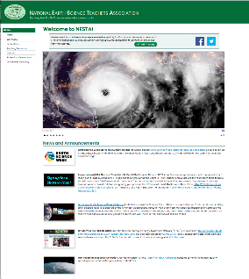
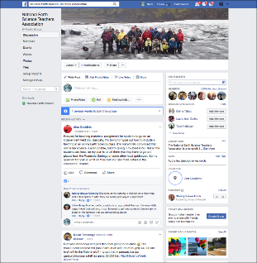

NESTA Internet Presence
  Website http://www.nestanet.org
    News and Announcements
    Professional Development
    Teaching Resources
    Educational Advocacy
  Join our Facebook Group and actively participate in the community https://www.facebook.com/groups/nationalesta/
  Follow us on Twitter @NESTA_US
    https://twitter.com/NESTA_US

Slide 5

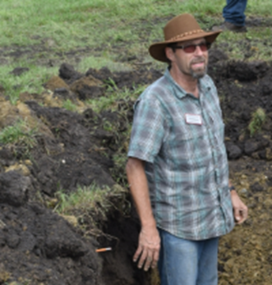

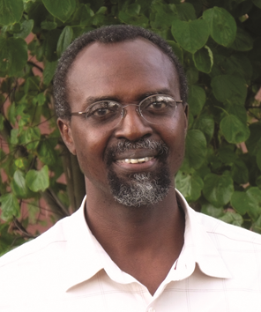
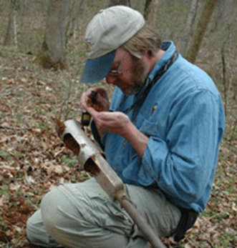
Our Speakers
Soil Overview |  | Soil Formation |  | Soil Characteristics |  | Soil Fertility
Clay Robinson |  | David Lindbo |  | Wale Adewunmi |  | Rachel Leege
Associate Professor of Soil Science, Illinois State University |  | Director, Soil Survey Division, USDA-NRCS |  | Soil and Environmental Scientist, Consultant |  | Manager of Student Programs, Soil Science Society of America
Soil Science Society of America

Slide 6
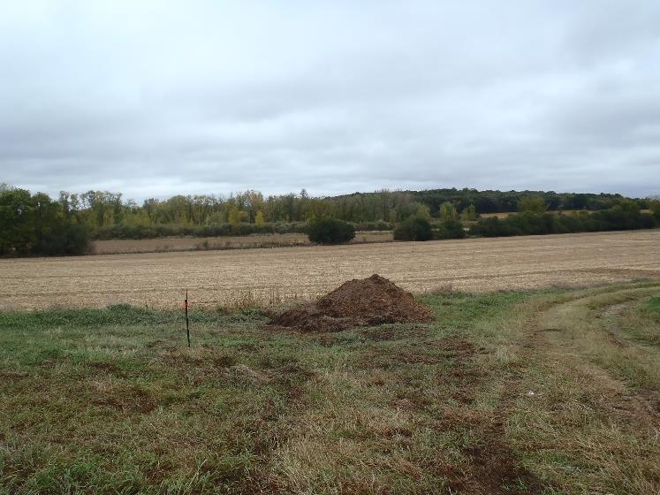

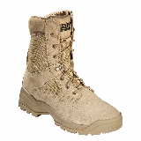
What is soil?
Soil is
the foundation for all terrestrial ecosystems,
and because it is always underfoot,
it is almost always overlooked,
and too often underappreciated.
Photo Credit: Clay Robinson
Soil Science Society of America

Slide 7
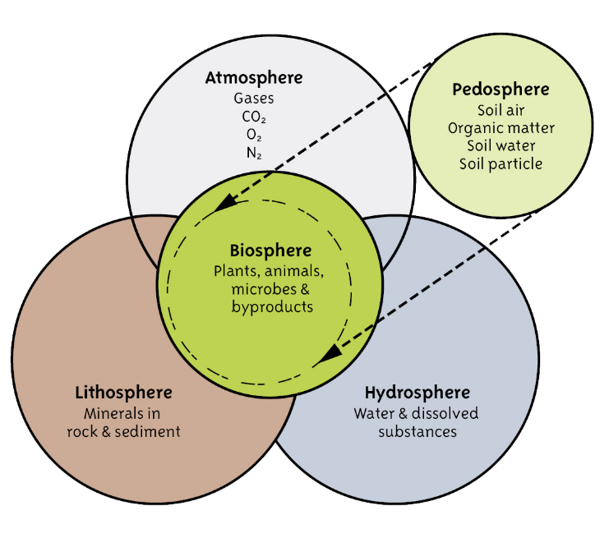
Soil – Intersecting All Spheres on Earth
Credit: Know Soil, Know Life book/Soil Science Society of America
Soil Science Society of America

Slide 8
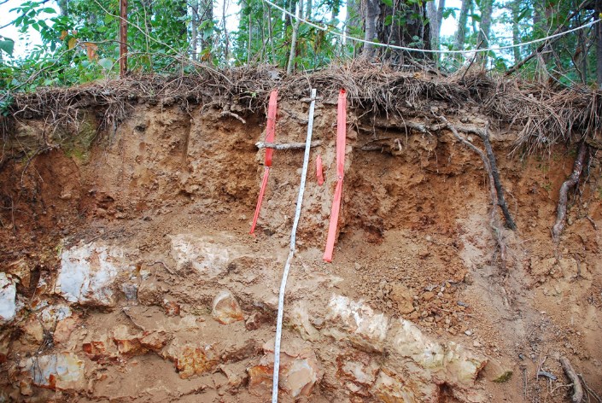
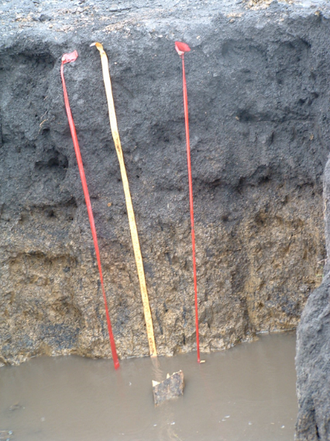
Soil: Intersection of
Atmosphere
Biosphere
Pedosphere (soil)
Lithosphere
Hydrosphere
Photo Credits: Clay Robinson
Soil Science Society of America

Slide 9
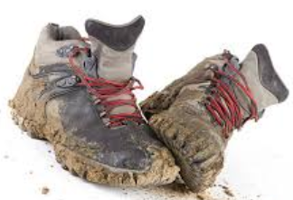
Soil
Is not dirt (under fingernails or on carpet)
Is a natural resource (slowly-renewable)
Is diverse, heterogeneous, dynamic
Supports life: microbes, plants, animals
Is important in the hydrologic cycle and water quality
Used for roads and buildings
Used for cultural activities (pottery, paints, dyes, etc.)
Different things to different people
A quick online search easily yields more than 15 definitions!
Soil Science Society of America

Slide 10
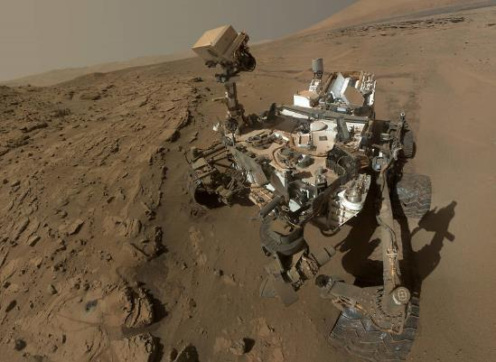
Is there soil on the moon or other planets?
Recently the Soil Science Society of America changed their definition of soil to allow the material at the surface of other planets to be considered soil, even though things aren’t growing in it, or it may not have water in it.
Last year, I would have said no, but now I have to say yes!
A soil scientist has been working with NASA for years with the Mars Rover Project!
Mars Curiosity Rover
Photo Credit: NASA
Soil Science Society of America

Slide 11
Soil is an applied science that uses
Chemistry - how things are made
Physics - how things move and work
Biology - how things live and grow
Hydrology - how water cycles through the soil-atmosphere systems, and where it is stored
Ecology - how all these systems affect plant and animal communities
Geology - how the minerals may affect soil properties
Soil Science Society of America

Slide 12
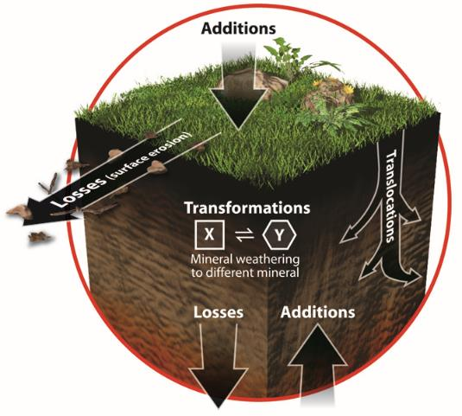
Soil forms from the surface downward by …
Additions
  Water percolates through soil
  Plants grow at the surface
Translocations
  Particles and minerals move down within the profile
Transformations
  Minerals are changed
Losses
  Erosion
  Leaching
Source: Soil! Get the Inside Scoop. Credit: Diagram based on N.C. Brady and R.R. Weil, 2008. The Nature and Properties of Soil. 14th Ed. Prentice Hall, Upper Saddle River, NJ.
Soil Science Society of America
Notes:
So after the general pathway slide this diagram should seem simple. Please remember that although we are simplifying the process all the processes are interacting. Soil is constantly changing due to the 4 processes. This means soil is dynamic –in a constant state of change. This diagram may help understand better how the processes affect the soil.
NOTE; If you asked students to list specific process ask them now to think about which of these general processes the specific ones would fit into. Some might fit into more than 1. You can put the 4 Basic Processes on the board as headings and then move the specific processes to the appropriate Basic Process.
From the examples previously:
Additions
Rain
Flooding – flood waters often leave sediment behind
Dumping – trash: although we should not condone this activity it does add materials to the soil
Deposition – any sediment by wind, water, glaciers etc. can be deposited on the surface. Humans can also add soil material (fill) to the soil as well
Leaf accumulation – leaf litter in the fall adds organic mater to the soil
Landslides – once the landslide material comes to rest it has been deposited on top of the existing soil
Losses
Leaching – this is a loss as leaching refers to materials being removed from the soil and into groundwater.
Erosion – this can be from wind, water or ice
Landslides – the materials that moves down slope off the land surface is a loss
Flooding – Although flooding can leave materials behind it can also remove material and move it down stream thus this is a loss
Translocations
Animals digging – animals from ants to moles to woodchucks to gophers dig holes and physically bring materials to the surface.
Mixing – humans disturb soil as do plants and burrowing animals
Plowing – all forms for tillage move soil around. It may non be far but soil below the surface is often brought up to the surface
Salting (from a student in western US referring to salinization of farm land) - salt moves due to evaporations
Transformations
Decomposition – an major transformation where organic matter such as fresh leaves is broken down by organisms into humus
Salting (from a student in western US referring to salinization of farm land) – the salts that move have to be dissolved in water before they can be moved. This is a transformation – solid to dissolved to solid again

Slide 13
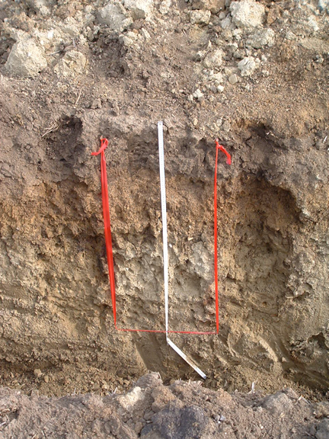
Soil Formation Processes
Additions
  Water percolates through soil
  Plants grow at the surface
Translocations
  Particles and minerals move down within the profile
Photo Credit: Clay Robinson
Soil Science Society of America
Notes:
So after the general pathway slide this diagram should seem simple. Please remember that although we are simplifying the process all the processes are interacting. Soil is constantly changing due to the 4 processes. This means soil is dynamic –in a constant state of change. This diagram may help understand better how the processes affect the soil.
NOTE; If you asked students to list specific process ask them now to think about which of these general processes the specific ones would fit into. Some might fit into more than 1. You can put the 4 Basic Processes on the board as headings and then move the specific processes to the appropriate Basic Process.
From the examples previously:
Additions
Rain
Flooding – flood waters often leave sediment behind
Dumping – trash: although we should not condone this activity it does add materials to the soil
Deposition – any sediment by wind, water, glaciers etc. can be deposited on the surface. Humans can also add soil material (fill) to the soil as well
Leaf accumulation – leaf litter in the fall adds organic mater to the soil
Landslides – once the landslide material comes to rest it has been deposited on top of the existing soil
Losses
Leaching – this is a loss as leaching refers to materials being removed from the soil and into groundwater.
Erosion – this can be from wind, water or ice
Landslides – the materials that moves down slope off the land surface is a loss
Flooding – Although flooding can leave materials behind it can also remove material and move it down stream thus this is a loss
Translocations
Animals digging – animals from ants to moles to woodchucks to gophers dig holes and physically bring materials to the surface.
Mixing – humans disturb soil as do plants and burrowing animals
Plowing – all forms for tillage move soil around. It may non be far but soil below the surface is often brought up to the surface
Salting (from a student in western US referring to salinization of farm land) - salt moves due to evaporations
Transformations
Decomposition – an major transformation where organic matter such as fresh leaves is broken down by organisms into humus
Salting (from a student in western US referring to salinization of farm land) – the salts that move have to be dissolved in water before they can be moved. This is a transformation – solid to dissolved to solid again

Slide 14
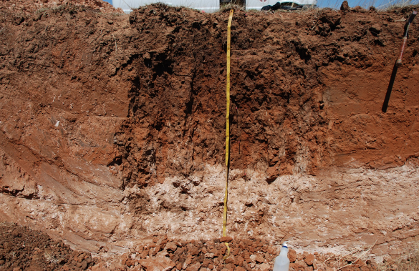
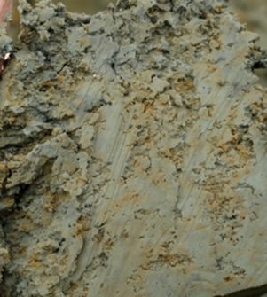
Soil Formation Processes
Translocations
  Particles and minerals move down within the profile
Transformations
  Minerals are changed
Photo Credit: Clay Robinson
Soil Science Society of America
Notes:
So after the general pathway slide this diagram should seem simple. Please remember that although we are simplifying the process all the processes are interacting. Soil is constantly changing due to the 4 processes. This means soil is dynamic –in a constant state of change. This diagram may help understand better how the processes affect the soil.
NOTE; If you asked students to list specific process ask them now to think about which of these general processes the specific ones would fit into. Some might fit into more than 1. You can put the 4 Basic Processes on the board as headings and then move the specific processes to the appropriate Basic Process.
From the examples previously:
Additions
Rain
Flooding – flood waters often leave sediment behind
Dumping – trash: although we should not condone this activity it does add materials to the soil
Deposition – any sediment by wind, water, glaciers etc. can be deposited on the surface. Humans can also add soil material (fill) to the soil as well
Leaf accumulation – leaf litter in the fall adds organic mater to the soil
Landslides – once the landslide material comes to rest it has been deposited on top of the existing soil
Losses
Leaching – this is a loss as leaching refers to materials being removed from the soil and into groundwater.
Erosion – this can be from wind, water or ice
Landslides – the materials that moves down slope off the land surface is a loss
Flooding – Although flooding can leave materials behind it can also remove material and move it down stream thus this is a loss
Translocations
Animals digging – animals from ants to moles to woodchucks to gophers dig holes and physically bring materials to the surface.
Mixing – humans disturb soil as do plants and burrowing animals
Plowing – all forms for tillage move soil around. It may non be far but soil below the surface is often brought up to the surface
Salting (from a student in western US referring to salinization of farm land) - salt moves due to evaporations
Transformations
Decomposition – an major transformation where organic matter such as fresh leaves is broken down by organisms into humus
Salting (from a student in western US referring to salinization of farm land) – the salts that move have to be dissolved in water before they can be moved. This is a transformation – solid to dissolved to solid again

Slide 15
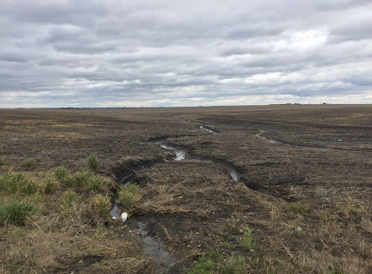
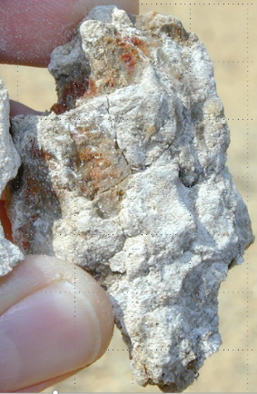
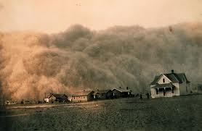
Soil Formation Processes
Losses
  Erosion
  Leaching
Left & Right Photo Credits: Clay Robinson; Middle Credit: Wikimedia Commons
Soil Science Society of America
Notes:
So after the general pathway slide this diagram should seem simple. Please remember that although we are simplifying the process all the processes are interacting. Soil is constantly changing due to the 4 processes. This means soil is dynamic –in a constant state of change. This diagram may help understand better how the processes affect the soil.
NOTE; If you asked students to list specific process ask them now to think about which of these general processes the specific ones would fit into. Some might fit into more than 1. You can put the 4 Basic Processes on the board as headings and then move the specific processes to the appropriate Basic Process.
From the examples previously:
Additions
Rain
Flooding – flood waters often leave sediment behind
Dumping – trash: although we should not condone this activity it does add materials to the soil
Deposition – any sediment by wind, water, glaciers etc. can be deposited on the surface. Humans can also add soil material (fill) to the soil as well
Leaf accumulation – leaf litter in the fall adds organic mater to the soil
Landslides – once the landslide material comes to rest it has been deposited on top of the existing soil
Losses
Leaching – this is a loss as leaching refers to materials being removed from the soil and into groundwater.
Erosion – this can be from wind, water or ice
Landslides – the materials that moves down slope off the land surface is a loss
Flooding – Although flooding can leave materials behind it can also remove material and move it down stream thus this is a loss
Translocations
Animals digging – animals from ants to moles to woodchucks to gophers dig holes and physically bring materials to the surface.
Mixing – humans disturb soil as do plants and burrowing animals
Plowing – all forms for tillage move soil around. It may non be far but soil below the surface is often brought up to the surface
Salting (from a student in western US referring to salinization of farm land) - salt moves due to evaporations
Transformations
Decomposition – an major transformation where organic matter such as fresh leaves is broken down by organisms into humus
Salting (from a student in western US referring to salinization of farm land) – the salts that move have to be dissolved in water before they can be moved. This is a transformation – solid to dissolved to solid again

Slide 16
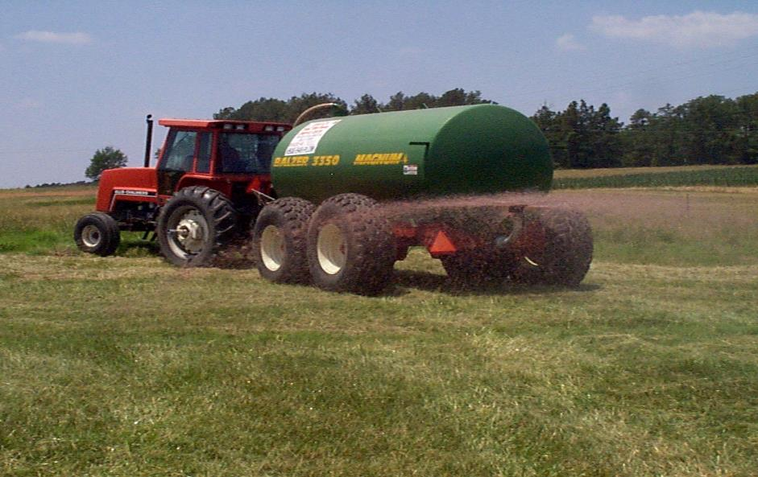
Additions
Photo Credit: David Lindbo
Soil Science Society of America
Notes:
Application of liquid animal waste as a fertilizer.
Addition
Fertilization

Slide 17
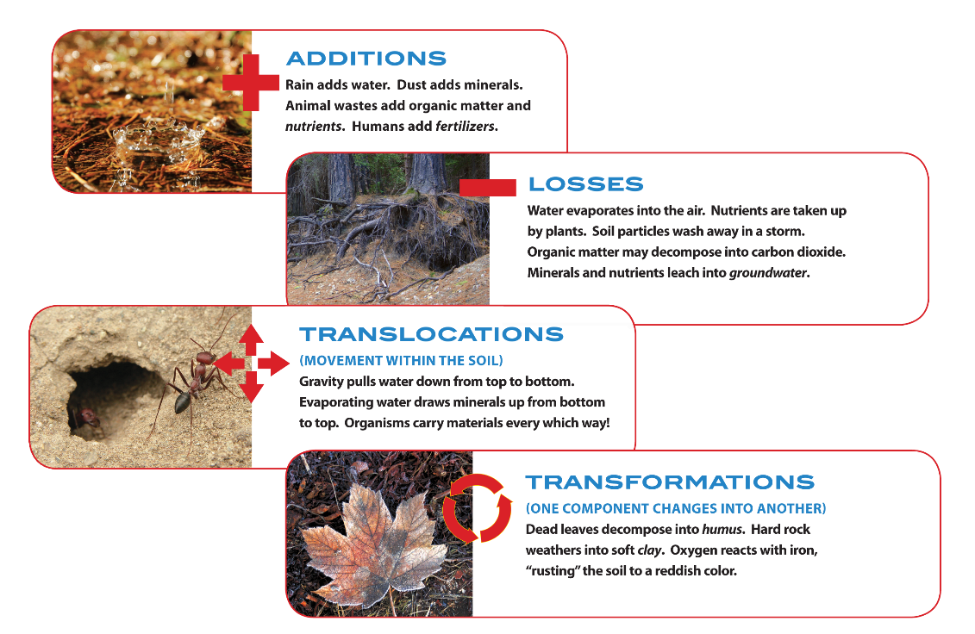

Source: Soil! Get the Inside Scoop, SSSA
Soil Science Society of America

Slide 18
Poll Question!
What fraction of earth's land is
suitable for agriculture?
Soil Science Society of America

Slide 19
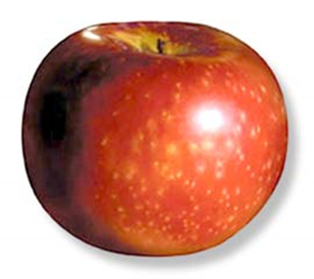
Starting with an apple
Activity Alert!
•Water covers 75% of Earth.
–So ¼ is not water
•Of that: ½ is polar ice caps, mountain ranges
–½ of ¼ = ⅛
•Of that, ¾ has a soil or climate problem
–¼ of ½ of ¼ is potentially arable
Soil Science Society of America

Slide 20
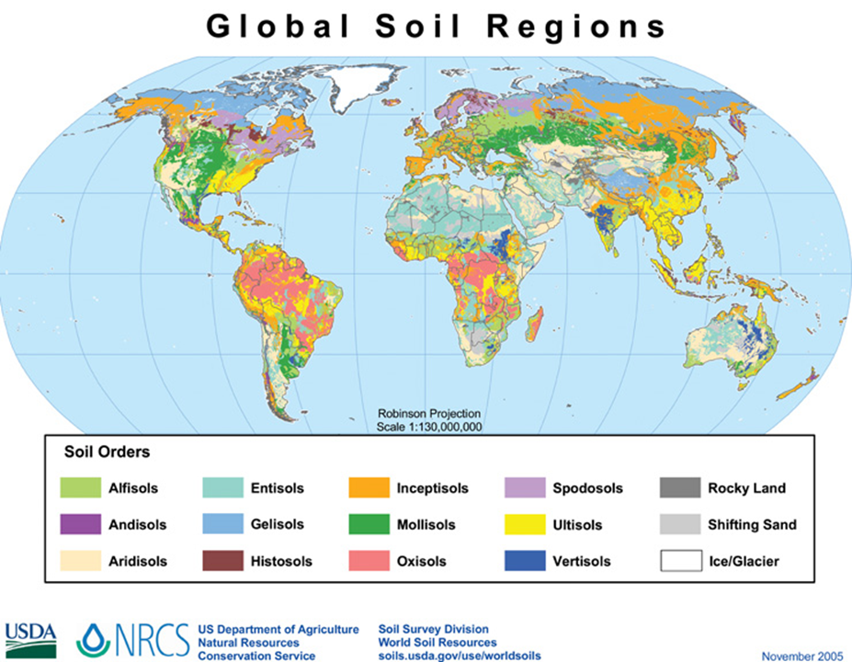

Slide 21
Factors of Formation or
Why do soils look different
The soil from
Cl.O.R.P.T.
Soil Science Society of America
Notes:
What are the factors of formation. To help you think of them think of things that influence you or have made you the way you are: i.e. parents = parent material; where you live = climate, vegetation; how old you are = time; influence of other (teachers etc) = anthropogenic

Slide 22
Factors of formation
Climate
Organisms
Relief
Parent Material
Time
Soil Science Society of America
Notes:
Jenny originally came up with the first 5 factors. Some add anthropogenic (man) as a 6th factor due to the extreme and widespread influence man can have, others consider man as part of the Biology factor.

Slide 23
The soil forms through the interaction of these factors.
Soil Science Society of America
Notes:
The soil forms through the interaction of these factors. No one factor is more important to the formation of a soil in the grand scheme but for the purposes of on-site wastewater site evaluation the influence of several individual factors may be paramount.

Slide 24
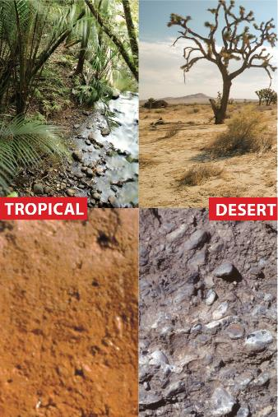
Climate
Temperature,
Rainfall, etc.
Source: Soil! Get the Inside Scoop, SSSA
Soil Science Society of America
Notes:
Climate, in particular, rainfall and temperature, can have profound effects on regional differences between soils. However, on a given 1 acre site, climatic conditions will generally be the same across it. Nonetheless a couple examples of the effects of climate on soil morphology.

Slide 25
Importance
Temperature
Precipitation
Dissolves materials
Plant growth
  Type
  Quantity
Biological activity
  Decomposition
  Mineralization
Translocations (leaching)
Transformation (chemical reaction)
Erosion
Plant growth
  Type
  Quantity
Biological activity
  Decomposition
  Mineralization
Evapotranspiration
Chemical reactions
  A 10ºC rise = 2-3x increase in reaction
Physical reactions
  freeze-thaw
Soil Science Society of America

Slide 26
Precipitation-Temperature Relations
Hot – Dry Desert
Cold – Dry Antarctica
Hot – Wet Tropics
Cold – Wet Northern Canada
Micro-climate
  Aspect
  Air drainage
  Elevation
Soil Science Society of America

Slide 27
Poll Question:
Where are the soils with the
highest amount of organic matter?
Soil Science Society of America

Slide 28
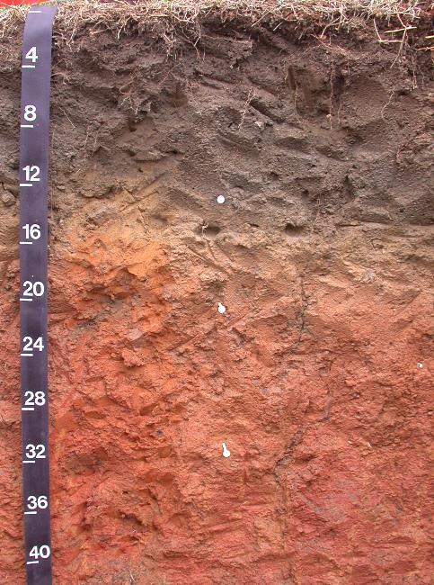
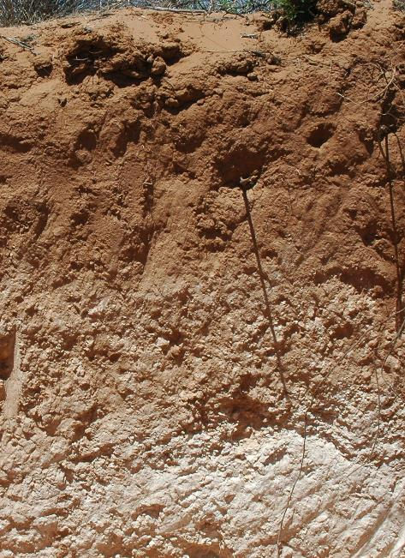
Climatic Differences
Photo Credits: David Lindbo
Soil Science Society of America
Warm - Humid
Warm - Dry

Slide 29
Organisms
aka
Vegetation or Biology
Soil Science Society of America
Notes:
Vegetation can have profound effects on differences between soils. However, on a given 1 acre site, the effects of vegetation/biology will generally be the same across it. Nonetheless a couple examples of the effects of climate on soil morphology.

Slide 30
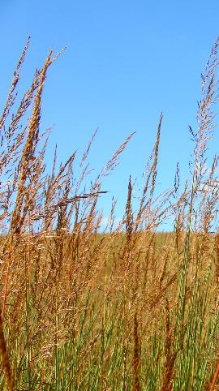
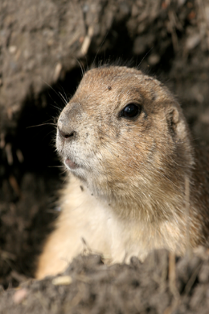
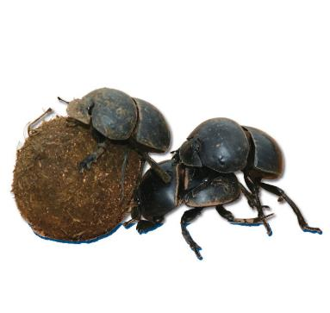
Organisms
Plants
  Grasses
  Coniferous
  Deciduous
Animals
  Burrowing
  Grazing
Micro- and Meso-organisms
  Bacteria
  Fungi
  Worms, Insects
Photos: Adobe Stock
Soil Science Society of America

Slide 31
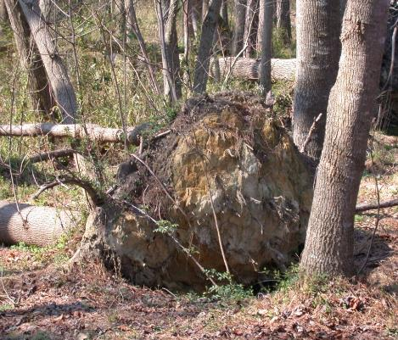
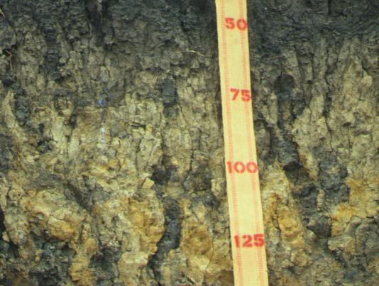
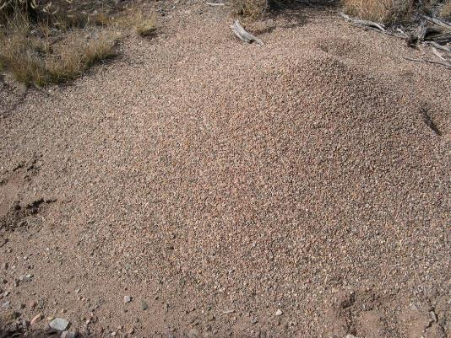
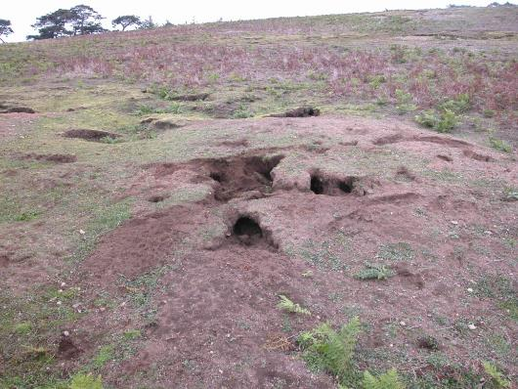
Biological mixing or Bioturbation
Activity Alert!
Tree Throws
Crayfish Burrows
Ant Hills
Photo Credits: David Lindbo
Rabbit Warrens
Soil Science Society of America

Slide 32
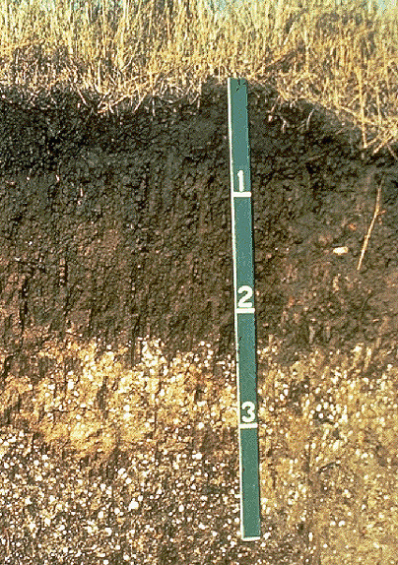
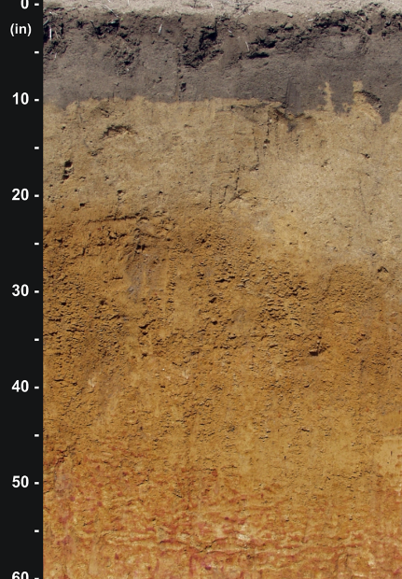
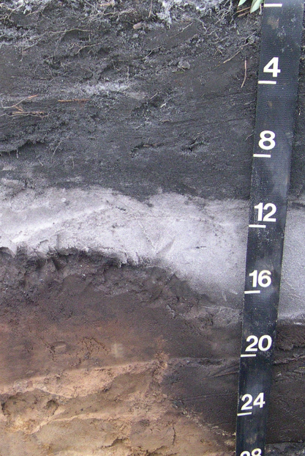
Vegetation
Grassland
Maple
Hemlock
O&A
O&A
E
Bhs
Bt
BC, CB
BC, CB
Ck
C
C
Photo Credits: David Lindbo
Soil Science Society of America

Slide 33
Relief
AKA
TOPOGRAPHY
Soil Science Society of America
Notes:
33
Topography or slope position can greatly influence soil development. Think to your if you would rather build a dream house on the top of a hill or the bottom. Why? The primary reason has to due with drainage and water movement. Soil developed on different parts of the landscape reflect the effects of drainage.

Slide 34
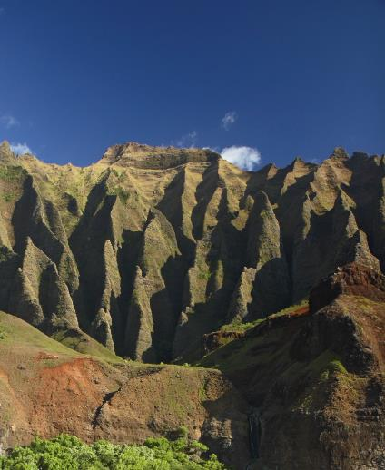
Relief, Topography or Slope
Degree of slope – erosion, stability
Location on the slope – water relations
Source: Soil! Get the Inside Scoop, SSSA
Soil Science Society of America

Slide 35
Measuring slope
Activity Alert!
100 cm
5 cm
% Slope = (5cm ÷ 100cm) x 100
% Slope = 0.05 x 100
% Slope = 5%
Image Credit: David Lindbo
Soil Science Society of America
Notes:
Here is a quick method of determining slope without specialized equipment. Must measure rise in tenths of feet, NOT inches.
1. Use a straight and true board.
2. Place level on board and lay board on the ground surface.
Raise the down slope end of the board until the board is level
Measure the distance from the bottom of the board at its end to the ground surface. This measurement needs to be in tenths of feet, NOT inches.
Follow the formula: (Rise ÷ Run) x 100 = % slope.
This measurement needs to be taken where the slope is uniform. Ideally a longer board is more accurate but more difficult to carry around. The board length could be shorter as well so long as the formula is used:
(Rise ÷ Run) x 100 = % slope

Slide 36
Relief – slope, shape, aspect
Profile thickness
OM content and thickness of A
Wetness
Color
Horizon expression
Chemistry (pH, base saturation, salts)
Temperature
Soil Science Society of America

Slide 37
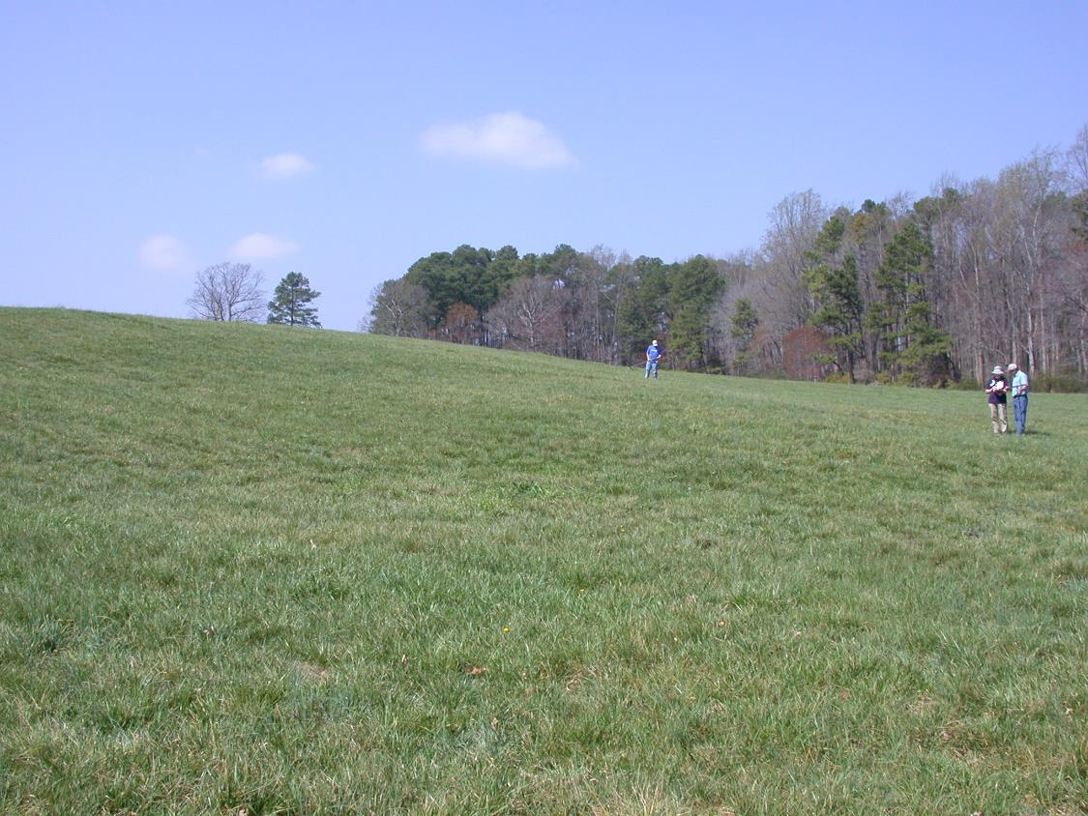
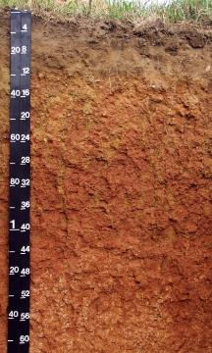
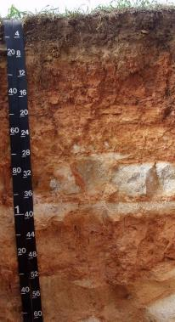
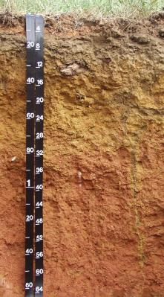
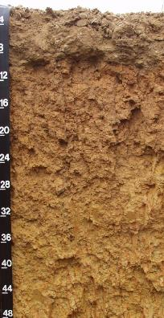
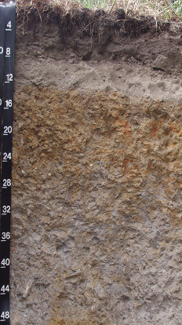
Slope Position Names
Summit
Shoulder
Side or back slope
Foot slope
Photo Credits: David Lindbo
Toe slope
Soil Science Society of America
Notes:
On a given landscape each part of the slope has a different name. Consider comparing the names to parts on your body; head = summit, ridge top, top etc., shoulder = shoulder slope, back or side = back or side slope, foot = foot slope, toe = toe slope.

Slide 38
Parent Material
Soils have parents too!
Soil Science Society of America
Notes:
Just as you and I have parents so do soils. Many of the soil properties as ours are inherited from their parents. Often these inherited properties can be the difference between a suitable vs. unsuitable soil for an on-site wastewater system.

Slide 39
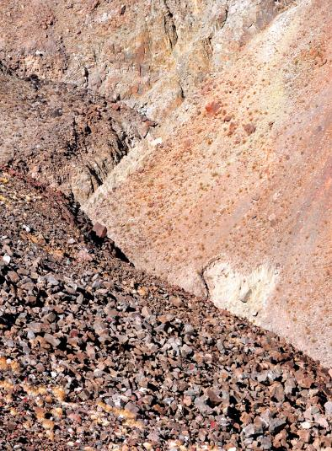
Parent Material
Transported materials
Bedrock or residual material
Organic materials
Source: Soil! Get the Inside Scoop, SSSA
Soil Science Society of America
Notes:
Parent materials can be broken into three basic groups.

Slide 40
deposited in wet areas
TRANSPORTED Parent Materials
ORGANIC
Parent Materials
Plants
deposited in lakes
Lacustrine
deposited by streams
Alluvial (fluvial)
deposited in or by oceans
Marine
RESIDUAL Parent Materials
water transported
gravity transported
Colluvial
Till:
basal, ablation,
deposited by ice
ice transported
Sediment
formed in place
deposited by water
Outwash, Lacustrine
Alluvial
Marine
wind transported
wind transported
wind transported
Credit: David Lindbo
Rocks
Aeolian (Eolian)
Soil Science Society of America
deposited by wind

Slide 41
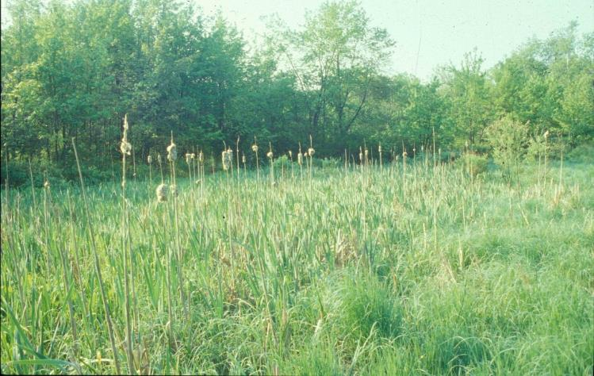
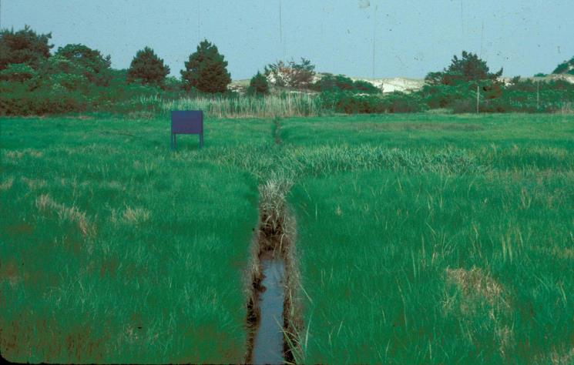
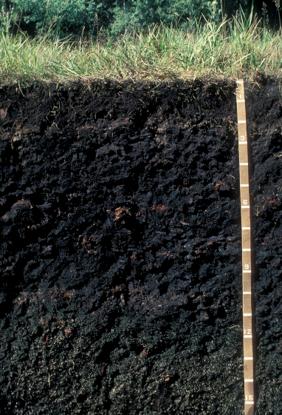
Organic
Accumulation of plant and animal debris – generally in wet environments
Photo Credit: David Lindbo
Soil Science Society of America

Slide 42
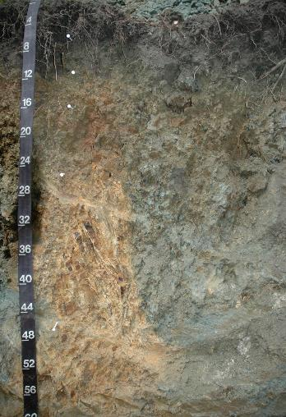
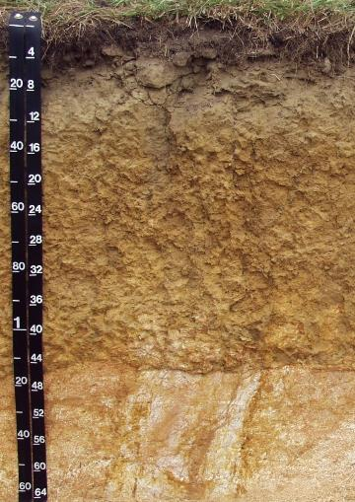
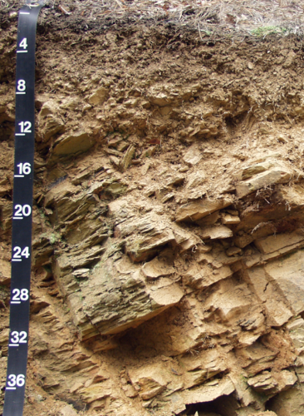
Residual Materials
Weathered and formed in place
Photo Credits: David Lindbo
Soil Science Society of America

Slide 43
Transported Materials
Materials that have moved and then weathered
Soil Science Society of America

Slide 44

Source: Know Soil, Know Life; SSSA
Soil Science Society of America

Slide 45






Water Transported Ice Transported
MARINE
LACUSTRINE
GLACIAL GLACIAL
TILL OUTWASH
FLUVIAL
Source: Lower Left-The Photo Gallery & Aerial Graphics, LLC; Upper right-Adobe Stock; all others David Lindbo
Soil Science Society of America
Notes:
Another feature of fluvial landscape is flood line. These lines help make the identification of flood prone areas easier. They also indicate that the parent materials are fluvial in origin and are therefore likely to have variable textures with depth.

Slide 46




Wind Transported
Source (L to R): Soil! Get the Inside Scoop, SSSA; USDA-ARS; http://www.pik-potsdam.de/~stock/lectures/earths_climate_ruddiman/ch13-the%20last%20glacial%20maximum/figure%2013-06.jpg; USGS
Soil Science Society of America

Slide 47

Time
Degree of soil formation
Source: Soil! Get the Inside Scoop, SSSA
Soil Science Society of America
Notes:
Time should be considered not only for hoe old a soil is but also in terms of long will it take for certain soil properties to develop or redevelop after a soil is disturbed.

Slide 48
Degree of Development
Hot – Dry Desert SLOW
Cold – Dry Antarctica SLOW
Hot – Wet Tropics FAST
Cold – Wet N. Canada SLOW
Time in soil formation is also relative
Soil Science Society of America

Slide 49


Young – few horizons
Photo Credits: David Lindbo
Older - more horizons
Soil Science Society of America

Slide 50
Poll Question!
How long does it take to
form an inch of soil?
Soil Science Society of America

Slide 51


General Time Sequence
Credit: David Lindbo
Soil Science Society of America

Slide 52
Factors of formation
Climate
Organisms
Relief
Parent Material
Time
Soil Science Society of America
Notes:
Jenny originally came up with the first 5 factors. Some add anthropogenic (man) as a 6th factor due to the extreme and widespread influence man can have, others consider man as part of the Biology factor.

