Slide 1


Module 5: Web Tools, Resources, Wrap-Up
Notes:
The purpose of Module 5 is to introduce the participants to webtools and resources they can integrate into their teaching.

Slide 2
Outline
Web Tools
Evaluation
Resources
Classroom Connections
Wrap-up
Notes:
This is the sequence of the slides in the this slide deck.

Slide 3
Soil Web Tools
NRCS Web Soil Survey - https://websoilsurvey.sc.egov.usda.gov/App/HomePage.htm
Soil Web - https://casoilresource.lawr.ucdavis.edu/gmap/
Notes:
In the past the USDA-NRCS worked with state soil conservation districts to create a survey of the soils in each district/county. These detailed assessments were available as volumes with aerial photos, maps, and detail descriptions of each soil type found. Since then, all this data has been migrated to searchable online tool available to anyone. There is another version of the NRCS Web Soil Survey produced by UC Davis called Soil Web. The tools compliment each other as some data is available on each. The webquest handout walks students through the use of both of them.

Slide 4
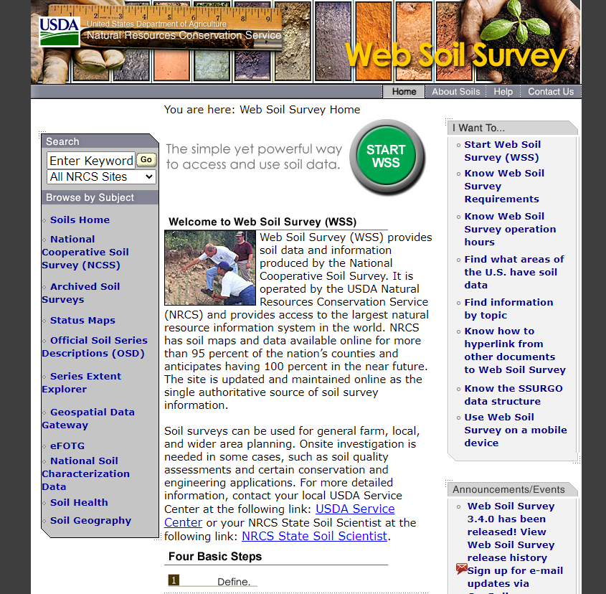
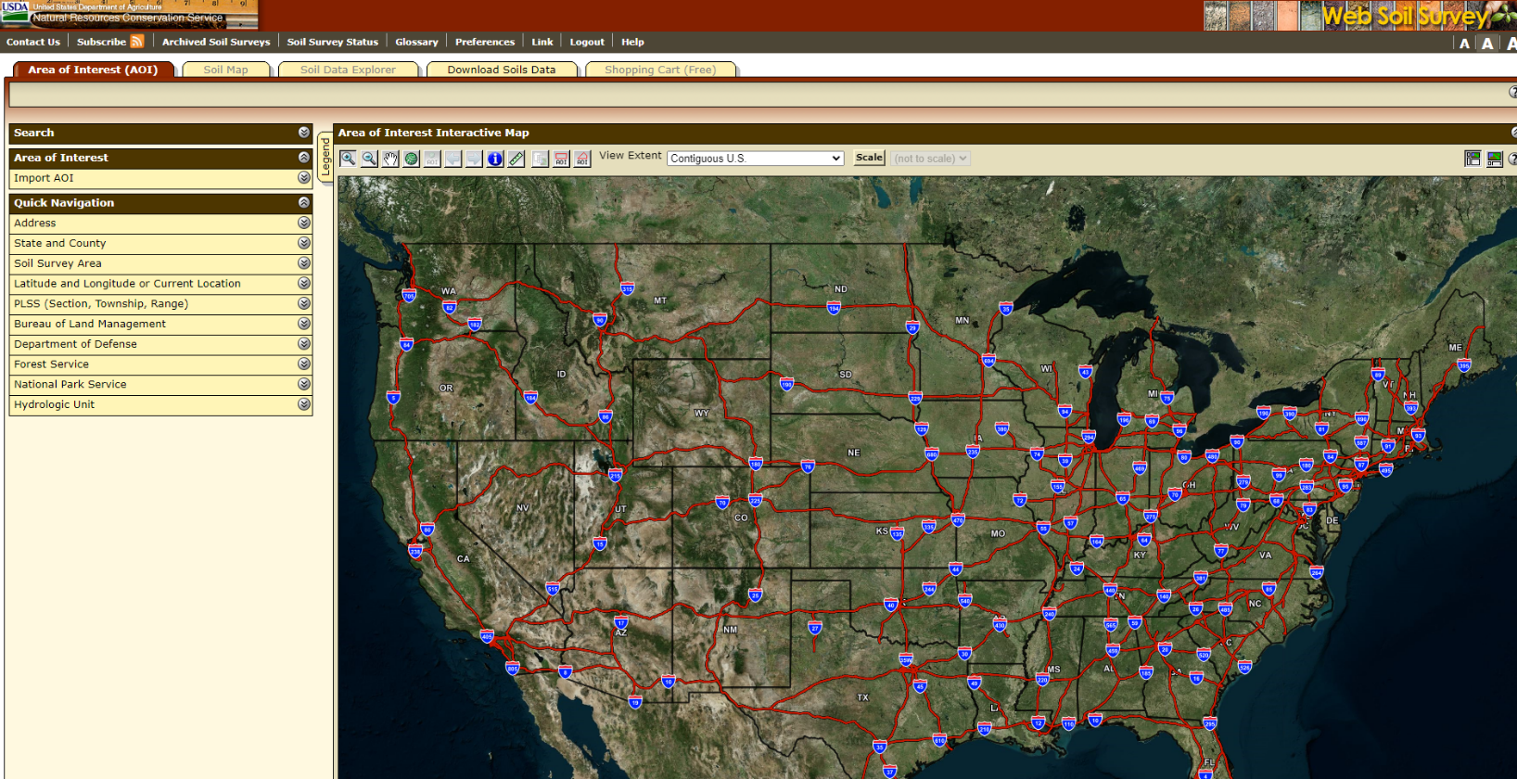
NRCS Web Soil Survey
Notes:
Open Web Soil Survey and demonstrate how to find a location, and information about the soil found there. Use the activity to guide this live search through the website.
https://websoilsurvey.sc.egov.usda.gov/App/HomePage.htm

Slide 5
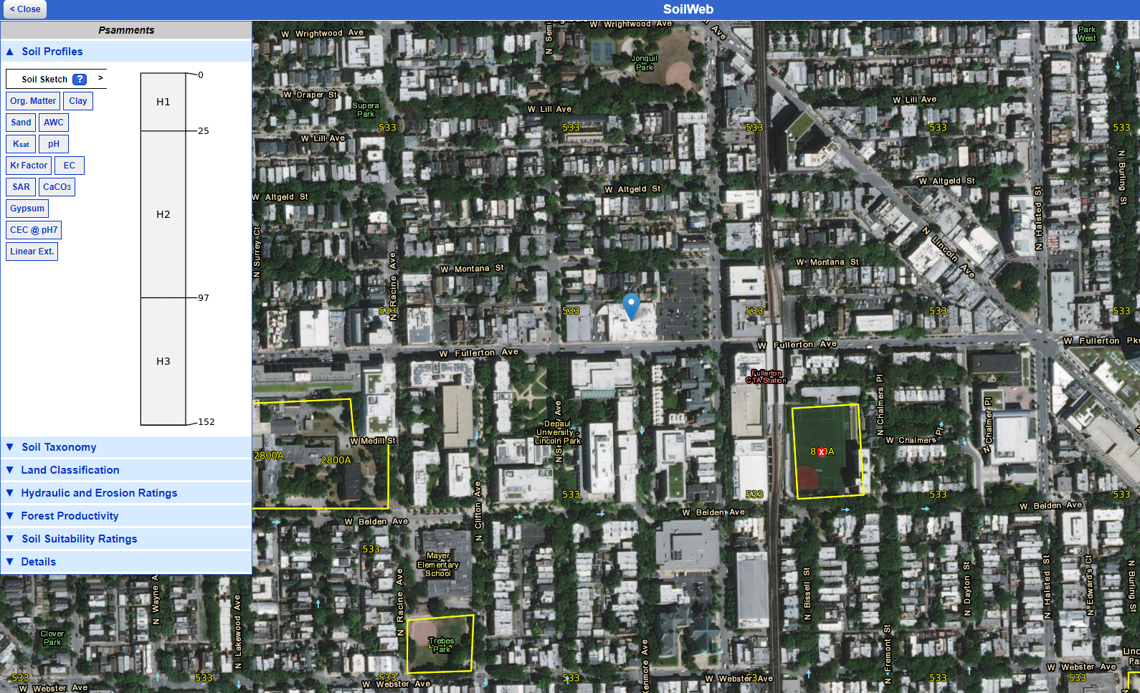
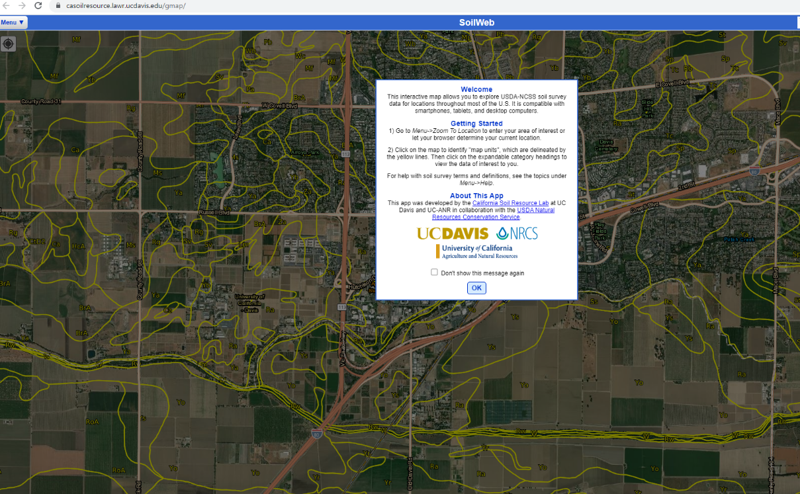
Soil Web
Notes:
Open Soil Web, and like WSS, walk the participants how to navigate the site, including how to locate soil profiles, and how it links in data from NRCS.
Soil Web - https://casoilresource.lawr.ucdavis.edu/gmap/

Slide 6
Workshop Evaluation
Notes:
Transition to evaluation. Share the evaluation link with participants, if using a digital platform for the evaluation.

Slide 7
Classroom Resources
Notes:
Transition to instructional resources available from SSSA.

Slide 8
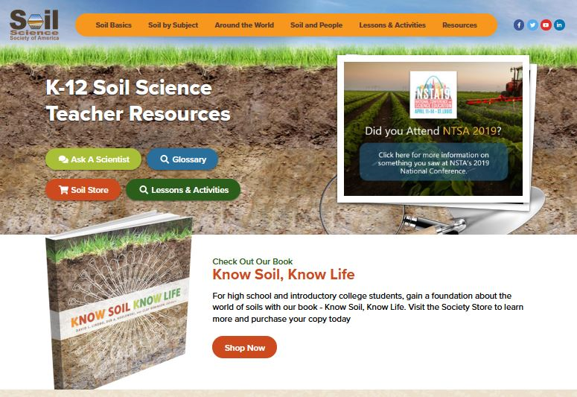
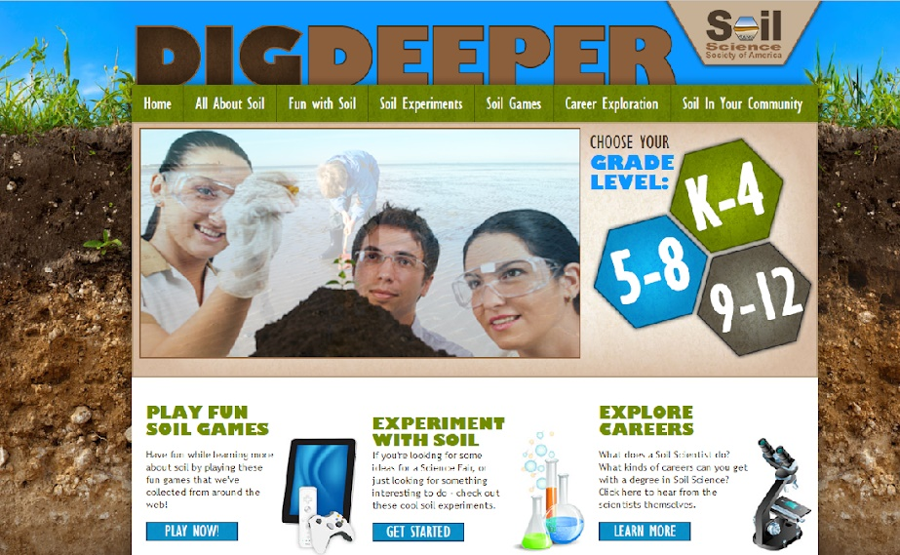
Websites
www.soils4teachers.org
www.soils4kids.org
Notes:
If time, provide a live walk-though of Soils 4 teachers and Soils 4 Kids. If not, point out how to access resources from various parts of the website using the screen shots.

Slide 9

I Heart Soil
14 languages
www.soils.org/stickers
Great giveaway!
Notes:
Mention that stickers are available upon request

Slide 10

Know Soil Know Life
Educator’s Guide
  Overview
  Powerpoints
  Activities
  Worksheets
Notes:
Mention that this is a perfect high school level textbook, and that a comprehensive teachers guide is available online.

Slide 11
Classroom Connections
Notes:
Time for participants to work together and share!

Slide 12
Soils in Your Classroom
How do you envision using what you learned today in your teaching?
Let’s break into groups and delve into planning (15 minutes)
Whole group report-out
Notes:
Report out from participants
Materials: sticky notes, markers, chart paper - if time is available

Slide 13
Workshop Wrap-up
From No Soil No Life to …
KNOW SOIL, KNOW LIFE
Thank You for Participating!
Notes:
Thank everyone, and especially the host institution.

