Slide 1
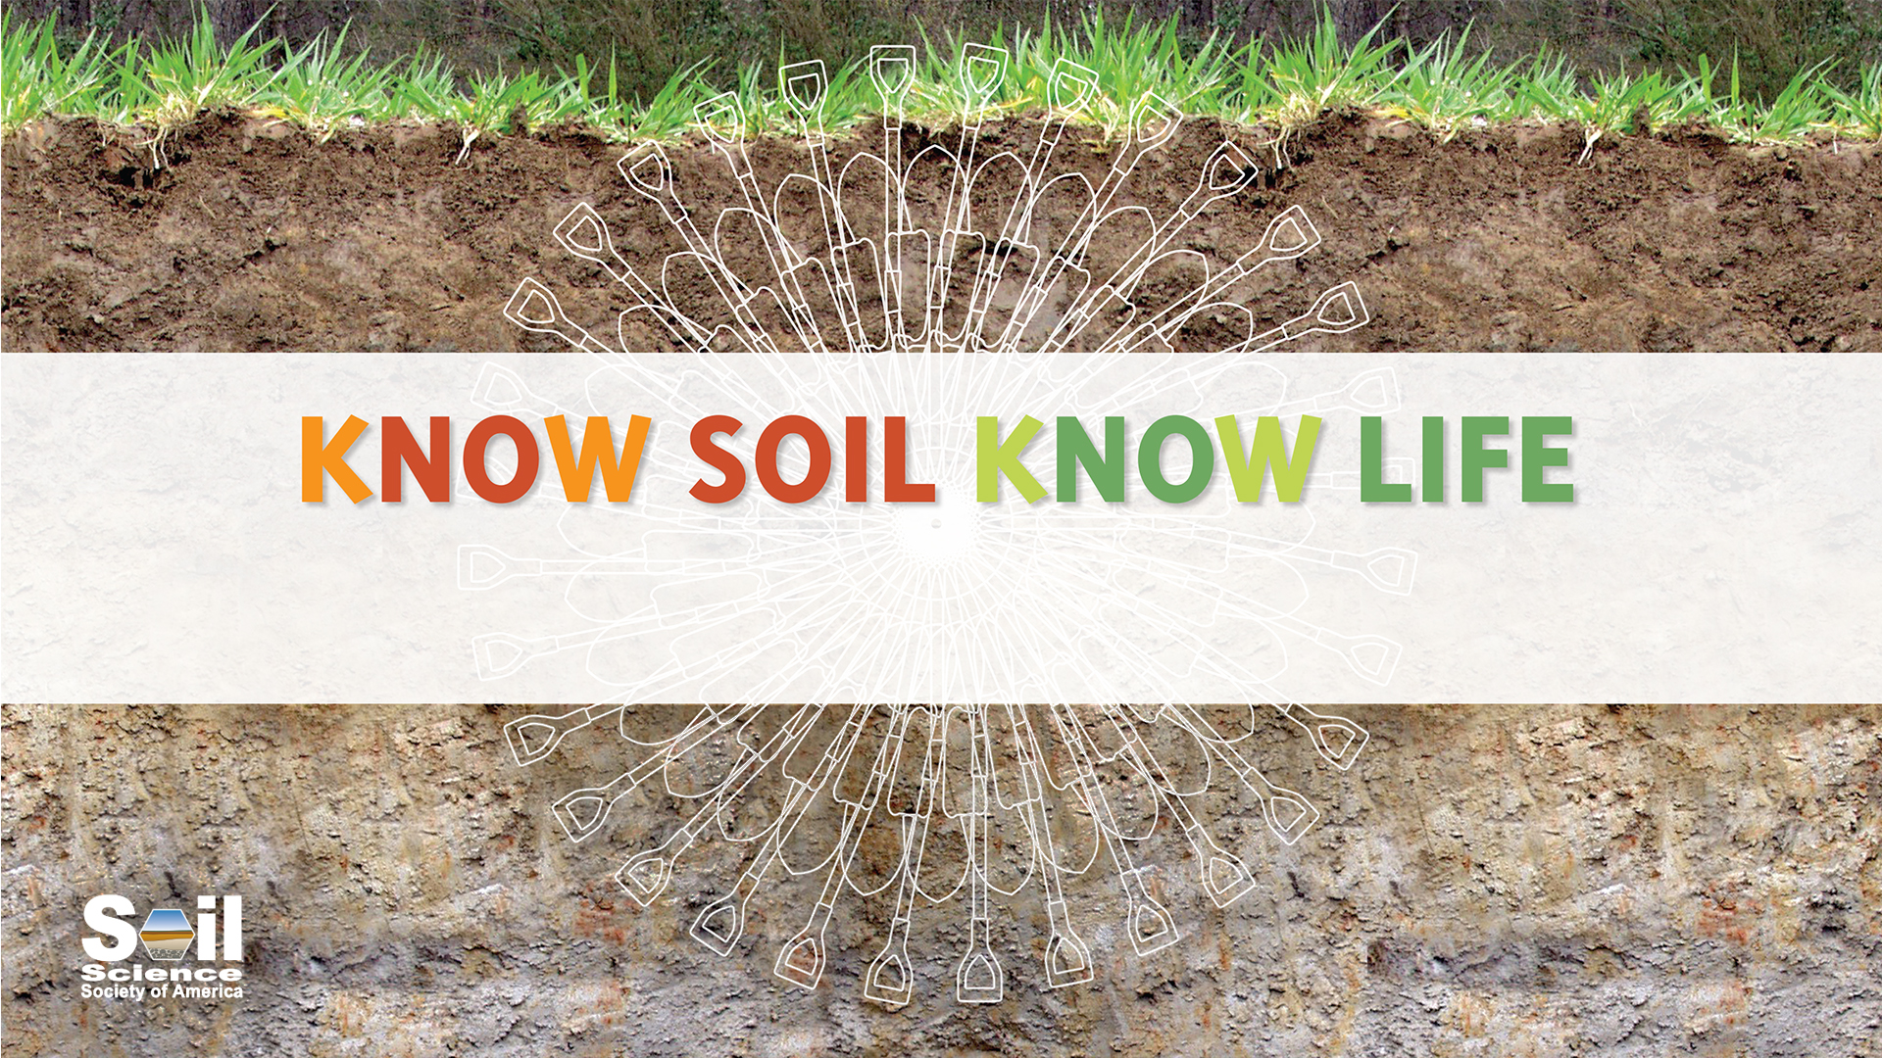
Module 2: Soil Chemistry

Slide 2
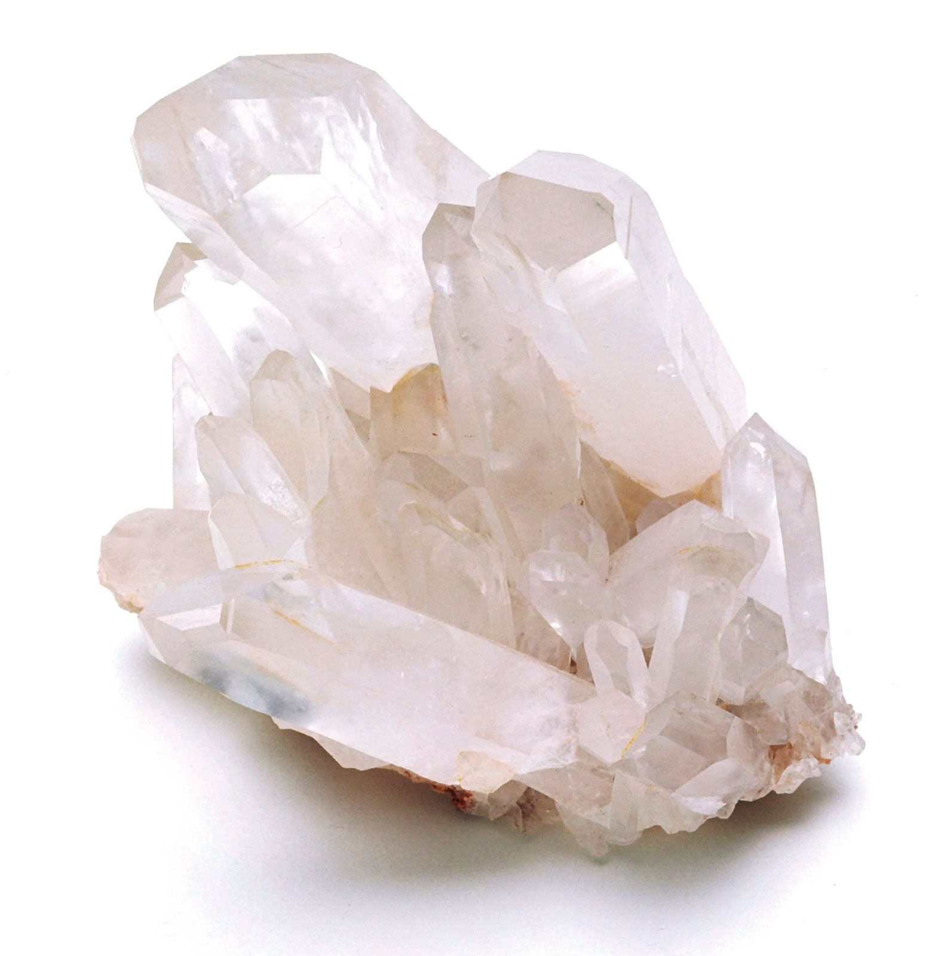
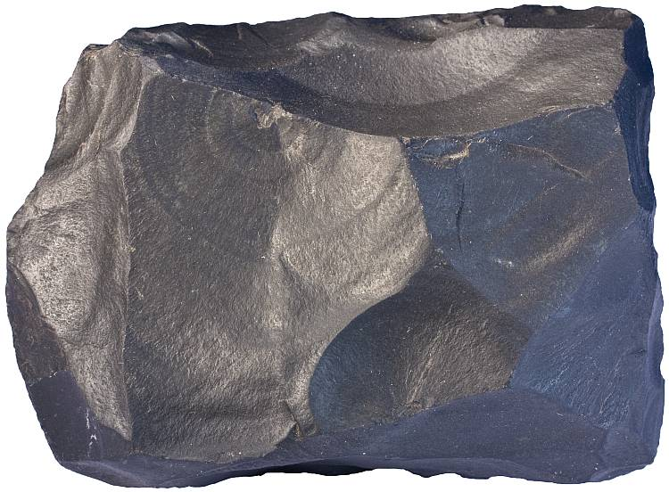
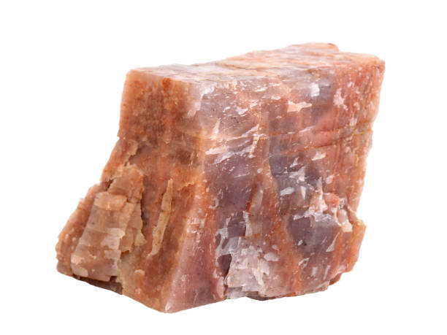
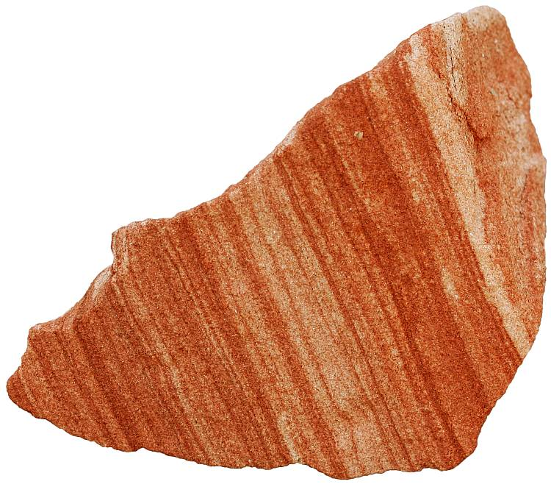
Introduction
Parent Materials
Quartz
Basalt
Feldspar
Sandstone
Notes:
Soils are derived from a variety of different rocks and minerals, called “parent materials.” Notice how each of the substances shown here look different? The soils that are derived from them look and behave differently as well.

Slide 3
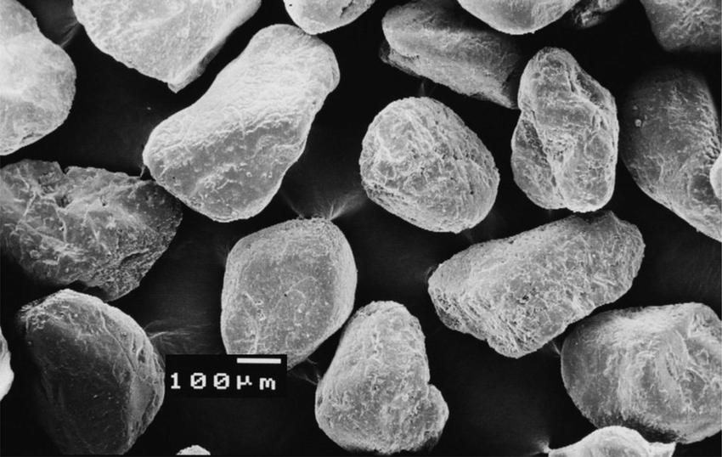
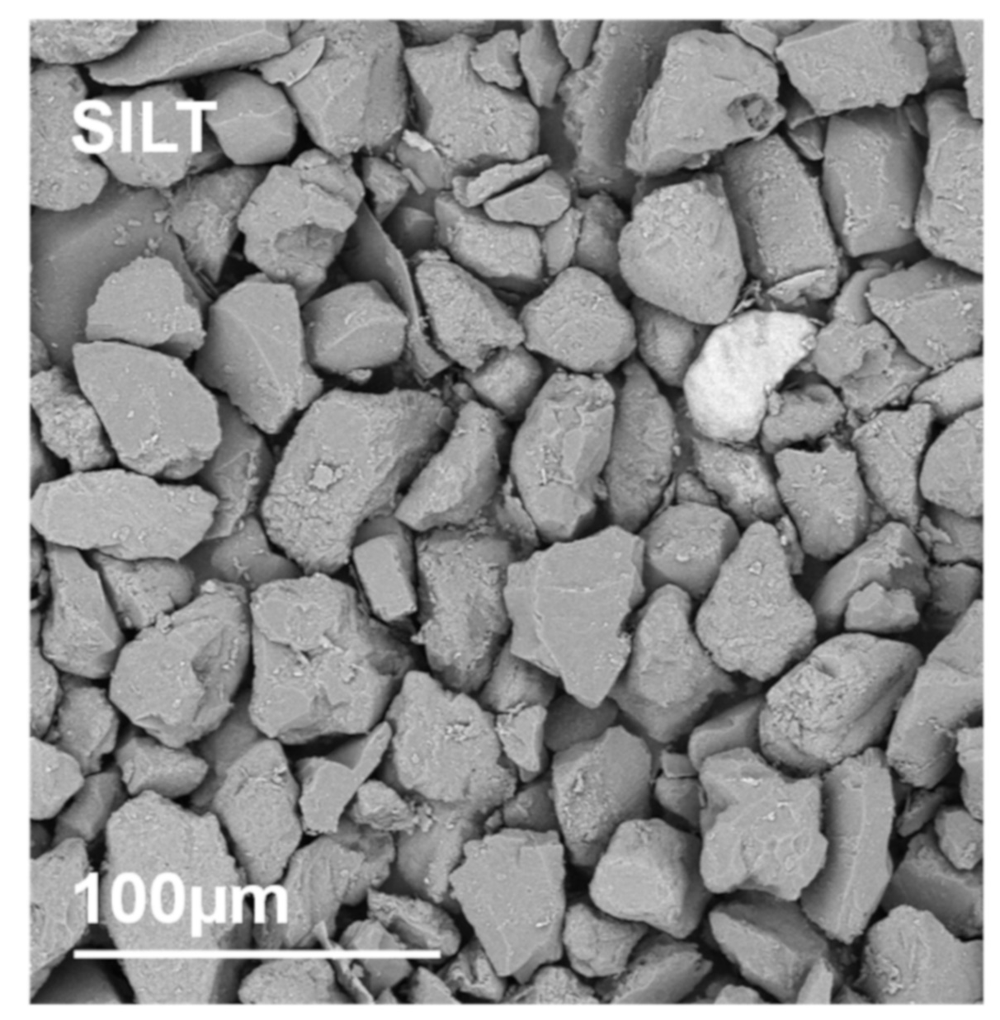
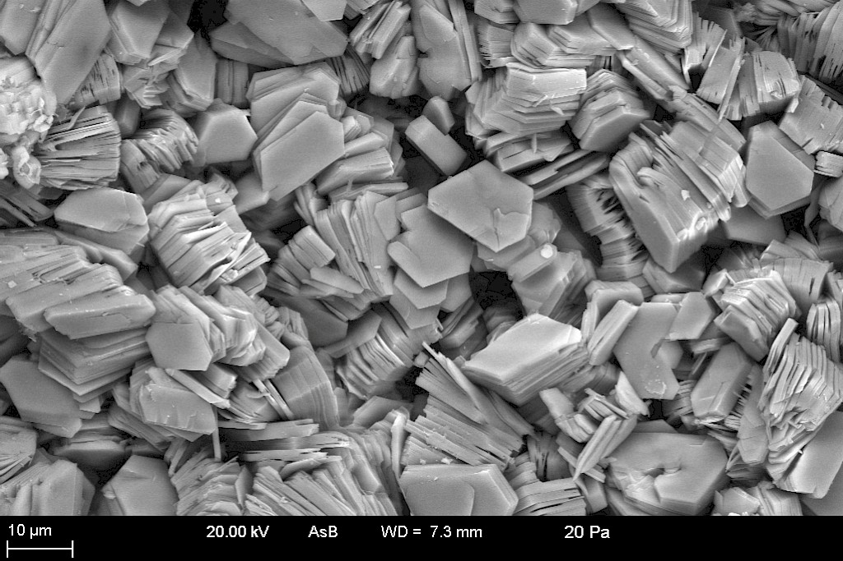
Introduction
Sand
0.05-2.0 mm
Silt
0.002-0.05 mm
Clay
<0.002 mm
Source: Saleh et al., 2015.
Source: Jozefaciuk et al., 2021.
Source: Clay Archive of Mineralogical Society of Great Britain & Ireland and the Clay Minerals Society.
Each bucket includes examples of these three primary soil particles!
Notes:
These images show the different particle sizes of soil, as well as their shapes. Notice that the scale of each image is different. Sand particles are relatively round, silt particles are more jagged, and clay particles exist in very thin sheets. The physical structure of clay gives these particles a much larger surface area than silt and sand particles, even though the clay particles themselves are much, much smaller.

Slide 4
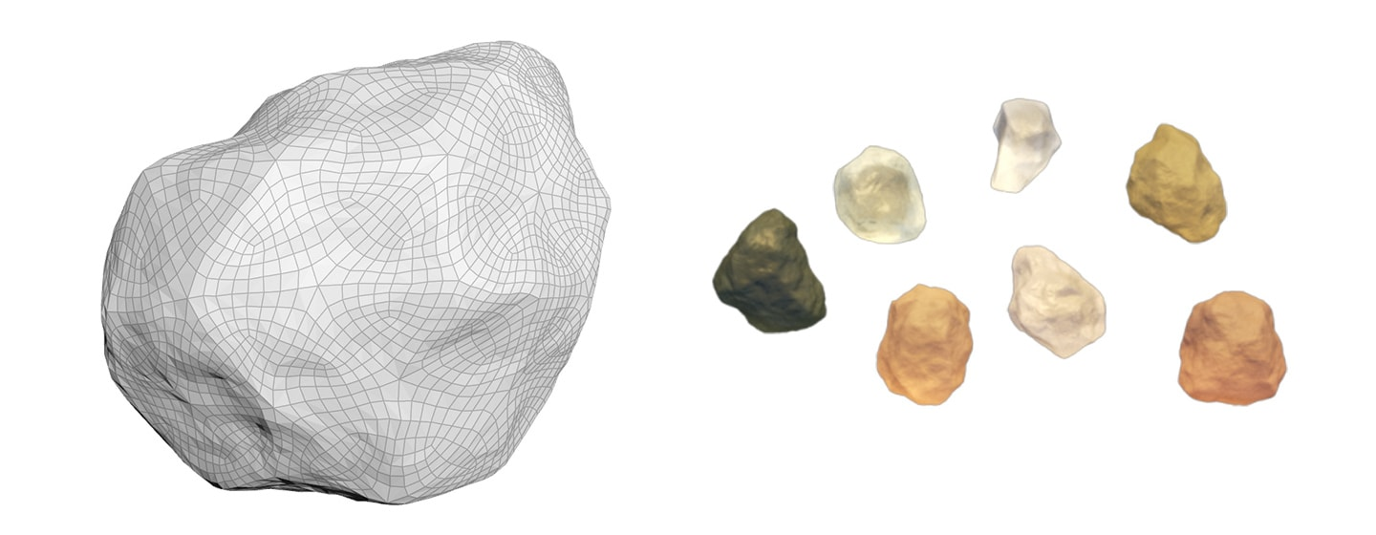
Introduction
Surfaces of sand particles typically do not have any charge (i.e., Si₂O₄)
Surfaces of clay particles generally have a negative charge (i.e., SiAlO₄⁻ )
Notes:
In addition to having a very high surface area, clay particles also have a large number of negatively charged reaction sites. Sand and silt particles have no or few charged sites, making them less reactive.

Slide 5
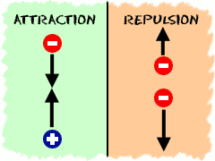
Introduction
A soil’s cation exchange capacity (CEC) is a measure of the total number of negatively-charged surfaces within the soil capable of adsorbing cations.
A soil with a high CEC will be able to capture and store a greater number of cations than a soil with a low CEC.
Both clay and organic matter have a high CEC.
Notes:
The negatively-charged reaction sites on clay particles can react with positively-charged ions (cations) like a magnet, holding the cations in place and not allowing them to move unless a cation with a stronger positive charger pushes them off. The more negatively charged reaction sites, the more cations a soil can hold. This is how soils remove contaminants from water.

Slide 6
Introduction
Cl⁻
Ca⁺
K⁺
Ca⁺
NO₃⁻
Cl⁻
NO₃⁻
K⁺
K⁺
NO₃⁻
Cl⁻
Ca⁺
Notes:
Animations show how positively charged ions (cations) move toward negatively-charged soil particles, and vice versa.

Slide 7
Soil is a Filter Activity
Objectives
1. Students will discover that soils physically and chemically filter impurities out of water.
2. Students will discover the role of soil in creating clean drinking water.
Meets the following Next Generation Science Standards:
  PS1.A: Structure of matter
  PS1.B: Chemical reactions

Slide 8
Soil is a Filter Activity
Materials and Preparation
3 oz and 5 oz paper cups
play sand
natural soil
grape Kool-aid
toothpicks
other colors, e.g., green, red, orange, yellow food coloring
“floaties”

Slide 9
Soil is a Filter Activity
*Note: The results are more dramatic if the play sand has been sieved to remove the smaller particles. If you do not have soil sieves, you can use a colander or a spaghetti strainer if the holes are small. Another material that makes a good sieve is screening. A fine screen attached to a small frame makes an excellent sieve.

Slide 10
Soil is a Filter Activity
Ask students some engaging questions before the activity:
What is a filter? (Show a coffee filter or a tea bag to aid discussion.)
Can soil be a filter?
Do all soils work the same?

Slide 11
Soil is a Filter Activity
Developing a Hypothesis:
Briefly explain the experiment.
We will use two soils- a sand by itself, and a sand with natural soil on top (the sand keeps the natural soil in the cup). We will add dirty water and Kool-aid to each of these soils to see what comes out!

Slide 12
Soil is a Filter Activity
Developing a Hypothesis:
Briefly explain experiment.
Have students make hypotheses and complete table.
For dirty water: What will happen to the "floaties"?
For Kool-aid: What color will come out the bottom?

Slide 13
Soil is a Filter Activity
Hypothesis Table
 |  | Dirty water | Kool-aid
Sand | Hypothesis
 | Observations
Soil | Hypothesis
 | Observations

Slide 14
Soil is a Filter Activity
Experimental setup
Take four 5 oz cups with holes in the bottom and fill them half full of sand.
2. Put each 5 oz cup inside a 3 oz cup. Put a toothpick between the cups so that air can escape from the bottom cup.

Slide 15
Soil is a Filter Activity
Methods: Sand + Dirty Water
Pour some of the dirty water into the first 5 oz. cup.
Watch as water filters into the bottom cup
Observe: What happens to the things floating in the water?
Record: Write your observations in the table.

Slide 16
Soil is a Filter Activity
Methods: Sand + Kool-aid
Pour some of the grape Kool-aid into the second 5 oz. cup.
Watch as water filters into the bottom cup
Observe: What color is the Kool-aid that goes into the cup?
What color is the water that collects in the bottom cup?
Record: Write your observations in the table.

Slide 17
Soil is a Filter Activity
Methods: Topsoil + Dirty Water
1. Fill the third 5-oz. cup up with topsoil after putting some sand in the bottom.
2. Pour some of the dirty water into the top cup.
Observe: What happens to the things floating in the water?
Record: Write your observations in the table.

Slide 18
Soil is a Filter Activity
Methods: Topsoil + Kool-Aid
Fill the fourth 5-oz. cup up with topsoil after putting sand in the bottom.
Pour some of the grape Kool-aid into the top cup.
Observe: What color is the Kool-aid that goes into the cup?
What color is the water that collects in the bottom cup?
Record: Write your observations in the table.

Slide 19
Soil is a Filter Activity
Discussion
Compare: Is the water in the bottom cup the same color for all four scenarios?
Based on what we’ve learned today, what do you think caused the differences in filtrate color between the sand and the natural soil?
Notes:
Filtrate water should vary in color between the four cups. This is due to the charges of the clay soil versus no (or little) charge in the sand.

Slide 20
Soil is a Filter Activity
Discussion
Remember that blue and red make purple and that clay particles and organic matter have many negative charges on their surface (high CEC).
Based on the color of the water that filtered out of the soils, what can you infer about the CEC of the two soils used here?
Notes:
The water should come out a pink-ish color. This means that the blue dye (positively charged) was retained in the soil, and most of the red dye (negatively charged) was not.

Slide 21
Take-home message
• Soil naturally filters water that falls as rain and goes into rivers.
• Soil filters many chemicals out of water just like it did the grape Kool-aid.
• These same techniques are used to purify wastewater that comes from houses, cities, industry, and large animal feeding operations.
A healthy soil is important for good drinking water!

Slide 22
Soil pH Activity
Objectives
1. Students will learn the effects of soil pH on nutrient availability.
Meets the following Next Generation Science Standards:
  PS1.A: Structure of matter
  PS1.B: Chemical reactions

Slide 23
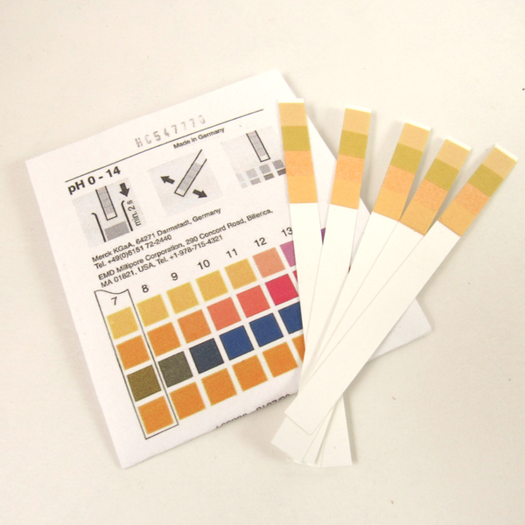
Soil pH Activity
Materials
pH test strips
Distilled water
Soil
Specimen jar w/ lid
  Alternative- cup w/ stirring rod

Slide 24
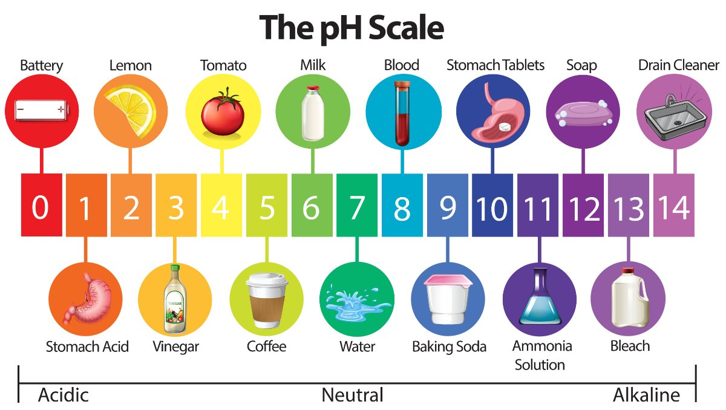
Soil pH Activity
Notes:
Use diagram to describe the pH scale. For younger students, you can discuss common acidic substances, like lemons, and how the sour taste is because of their acidity. For older students, you can describe the relationship between pH and the concentration of hydrogen ions in a substance: pH = -log(H⁺).

Slide 25
Soil pH Activity
Start by discussing with students why soil pH might be important.
Where are other areas pH is important?
  Cooking
  Aquatic habitats
  In the soil!
Notes:
Many students will not know why soil pH might be important, so the instructor may need to help them along with this.

Slide 26
Soil pH Activity
There are 16 necessary nutrients for plant growth:
C, H, O, P, K, N, S, Ca, Fe, Mg, B, Mn, Cl, Cu, Zn, Mo
arbon
ydrogen
xygen
hosphorus
potassium
i
trogen
ilicon
alcium
i
ron
agnesium
oron
anganese
hlorine
opper
inc
olybdenum
Notes:
More information: https://endofite.com/essential-plant-nutrients/. Note: different websites have slightly different versions of this list, but the major plant necessary nutrients are the same.

Slide 27
Soil pH Activity
Mnemonic device time!
“Chopkin’s café is managed by mine close cousin, Moe.”
CHOPKNS CaFe Mg B Mn Cl CuZn Mo.

Slide 28
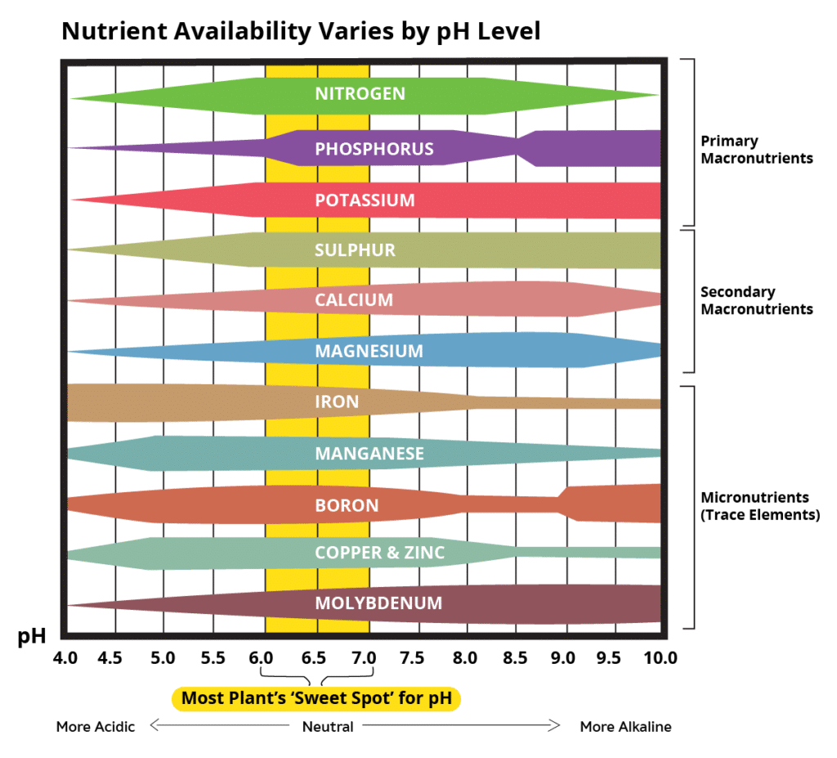
Soil pH Activity
Nutrient availability varies with soil pH
Example questions:
  At what pH is magnesium most available?
  Boron?
  Phosphorus?
Notes:
If plants need all 16 nutrients to be healthy, then the soil needs to be at a pH that ensures that all of those nutrients are available. This tends to be a pH of 6.0-7.0. If a certain type of plant grows well in soil of a certain pH (e.g., azaleas like acidic soils, pH = 4.5-6.0), this is likely because there is a nutrient that the plant likes that is more available at that pH. For azaleas, this nutrient is iron.

Slide 29
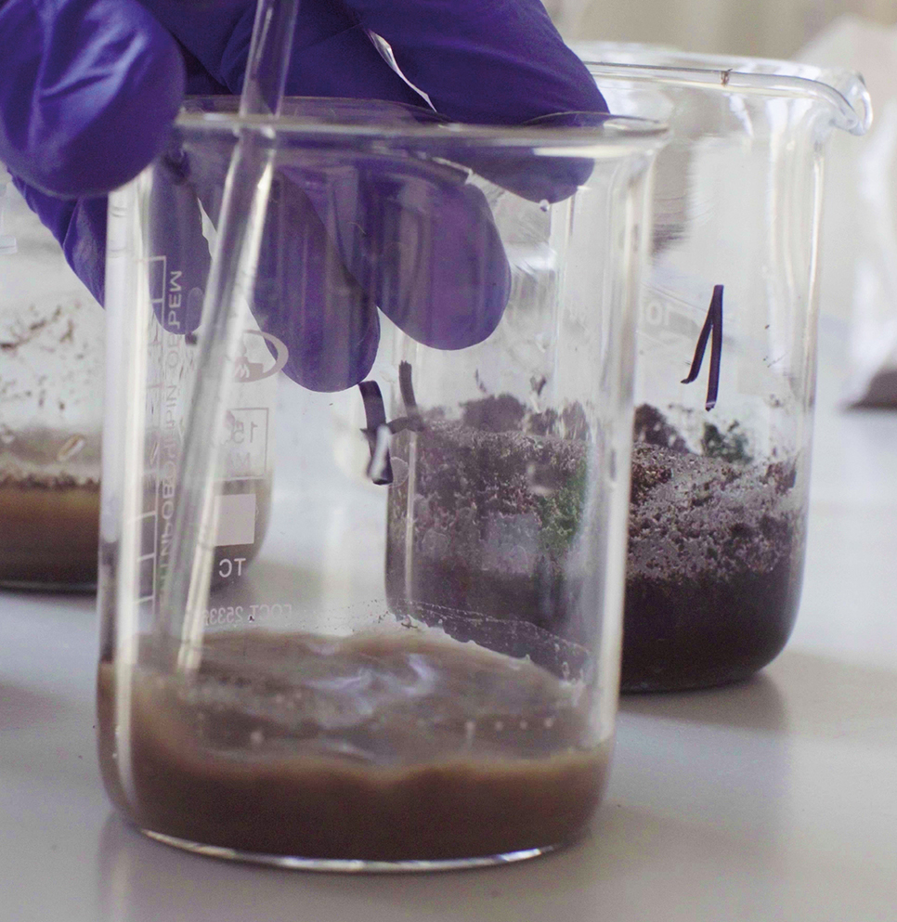
Soil pH Activity
Place 1/8 cup (30 g) of soil into a cup or jar
Add 1/8 cup (30 g) of distilled water
Cover the cup or jar and shake vigorously ~25 times
  Alternatively, stir the soil-water mixture with a stirring rod

Slide 30
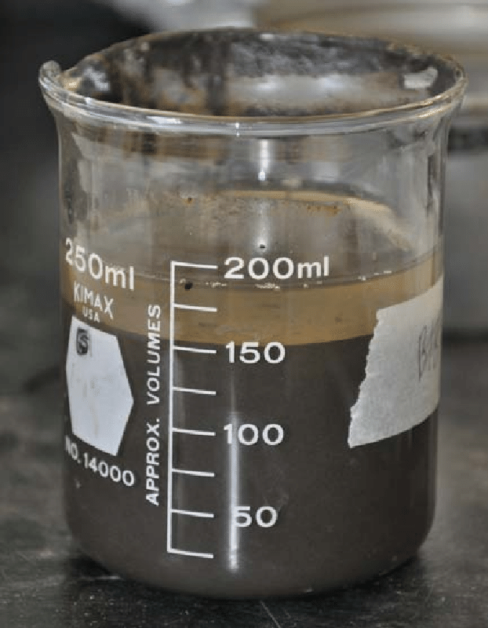
Soil pH Activity
  Allow the mixture to settle for 10-15 minutes
  Insert the tip of the pH paper into the supernatant (water above the settled soil).

Slide 31
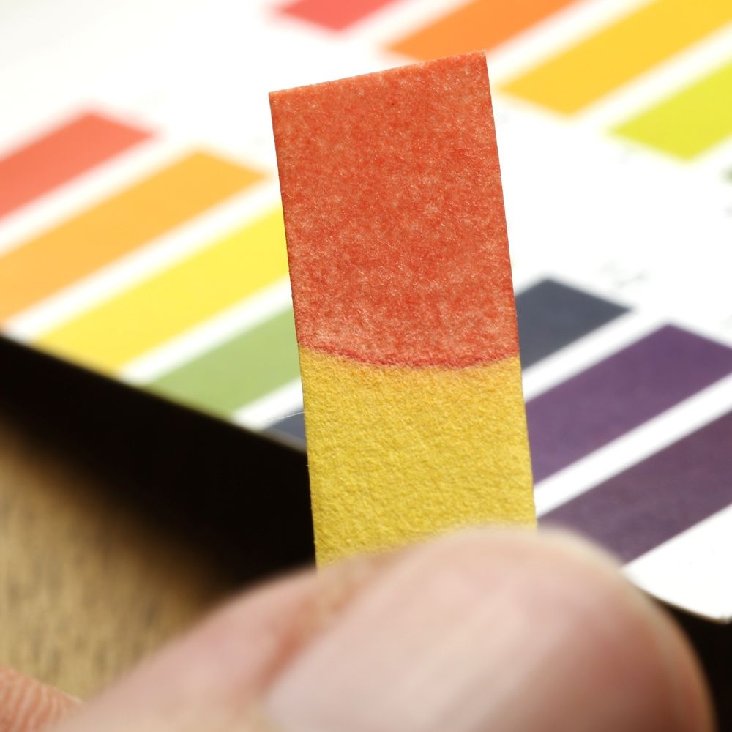
Soil pH Activity
Let the paper dry for 60 seconds, then compare to the pH color chart to determine the soil’s pH.

Slide 32
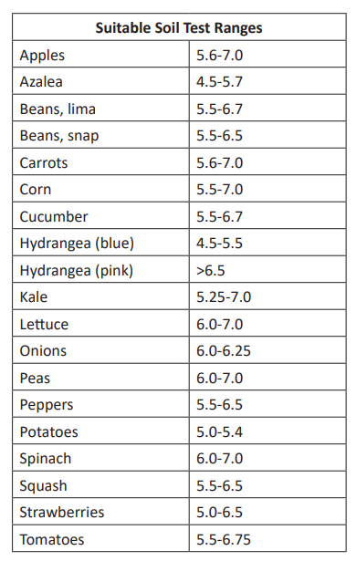
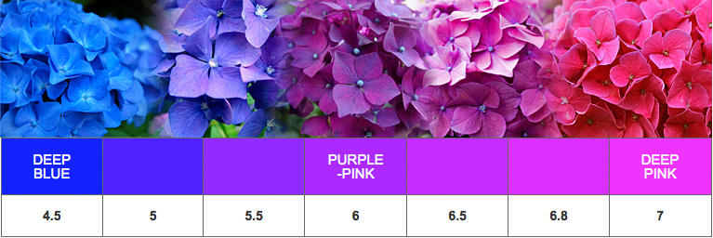
Soil pH Activity
What plants would grow best in your soil?
Notes:
Hydrangeas are a great example of a plant that is sensitive to soil pH. When the soil pH is low, they are blue; when it is high, they are pink. This is due to differences in aluminum variability at different pH levels.

Slide 33
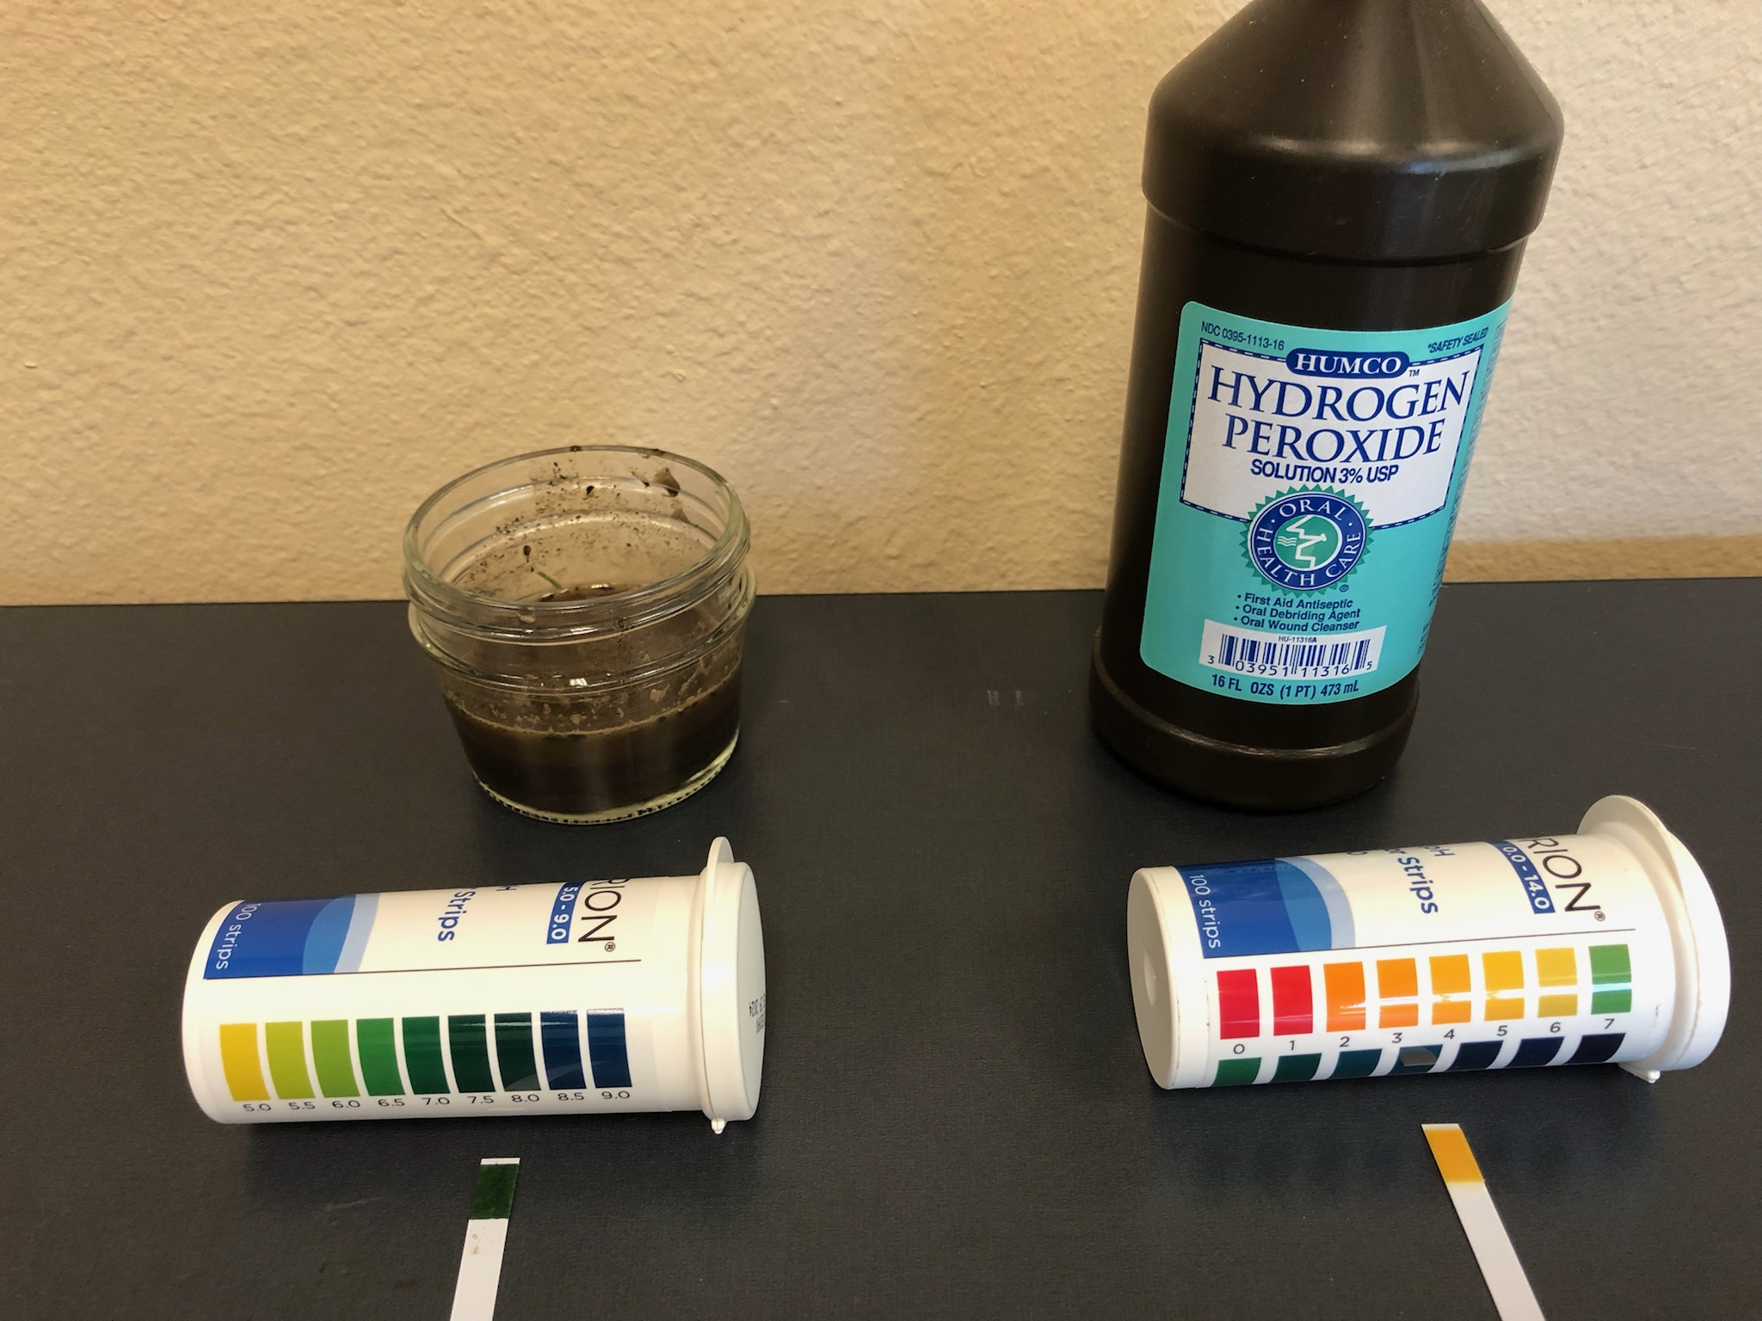
Soil pH Activity
Test Your Soil pH
  What plants grow best?
Compare with other items such as:
  Orange juice
  Vinegar/lemon juice
  Coke
  Milk
  Hydrogen peroxide
  Bleach

Slide 34
Soil Chemistry Resources
Know Soil Know Life, Chapter 4:
  Chemical Properties of Soil: Soil Fertility and Nutrient Management
Know Soil Know Life Educators Guide, Online:
  https://serc.carleton.edu/kskl_educator/soil_chemistry/index.html

