Slide 1


Welcome!

Slide 2
Welcome
Introductions
  Briana Wyatt, Texas A&M University
  Jenn DeBruyn, University of Tennessee, Knoxville
  Missy Holzer, Great Minds, PBC
  Maninder Walia, University of Nevada, Reno
  Susan Chapman, Soil Science Society of America

Slide 3
Workshop Logistics
Our Host: Dr. James Montgomery
Associate Professor
DePaul University
Notes:
Introduce the University, and the department, provide access to WiFi, note where restrooms are located, etc

Slide 4
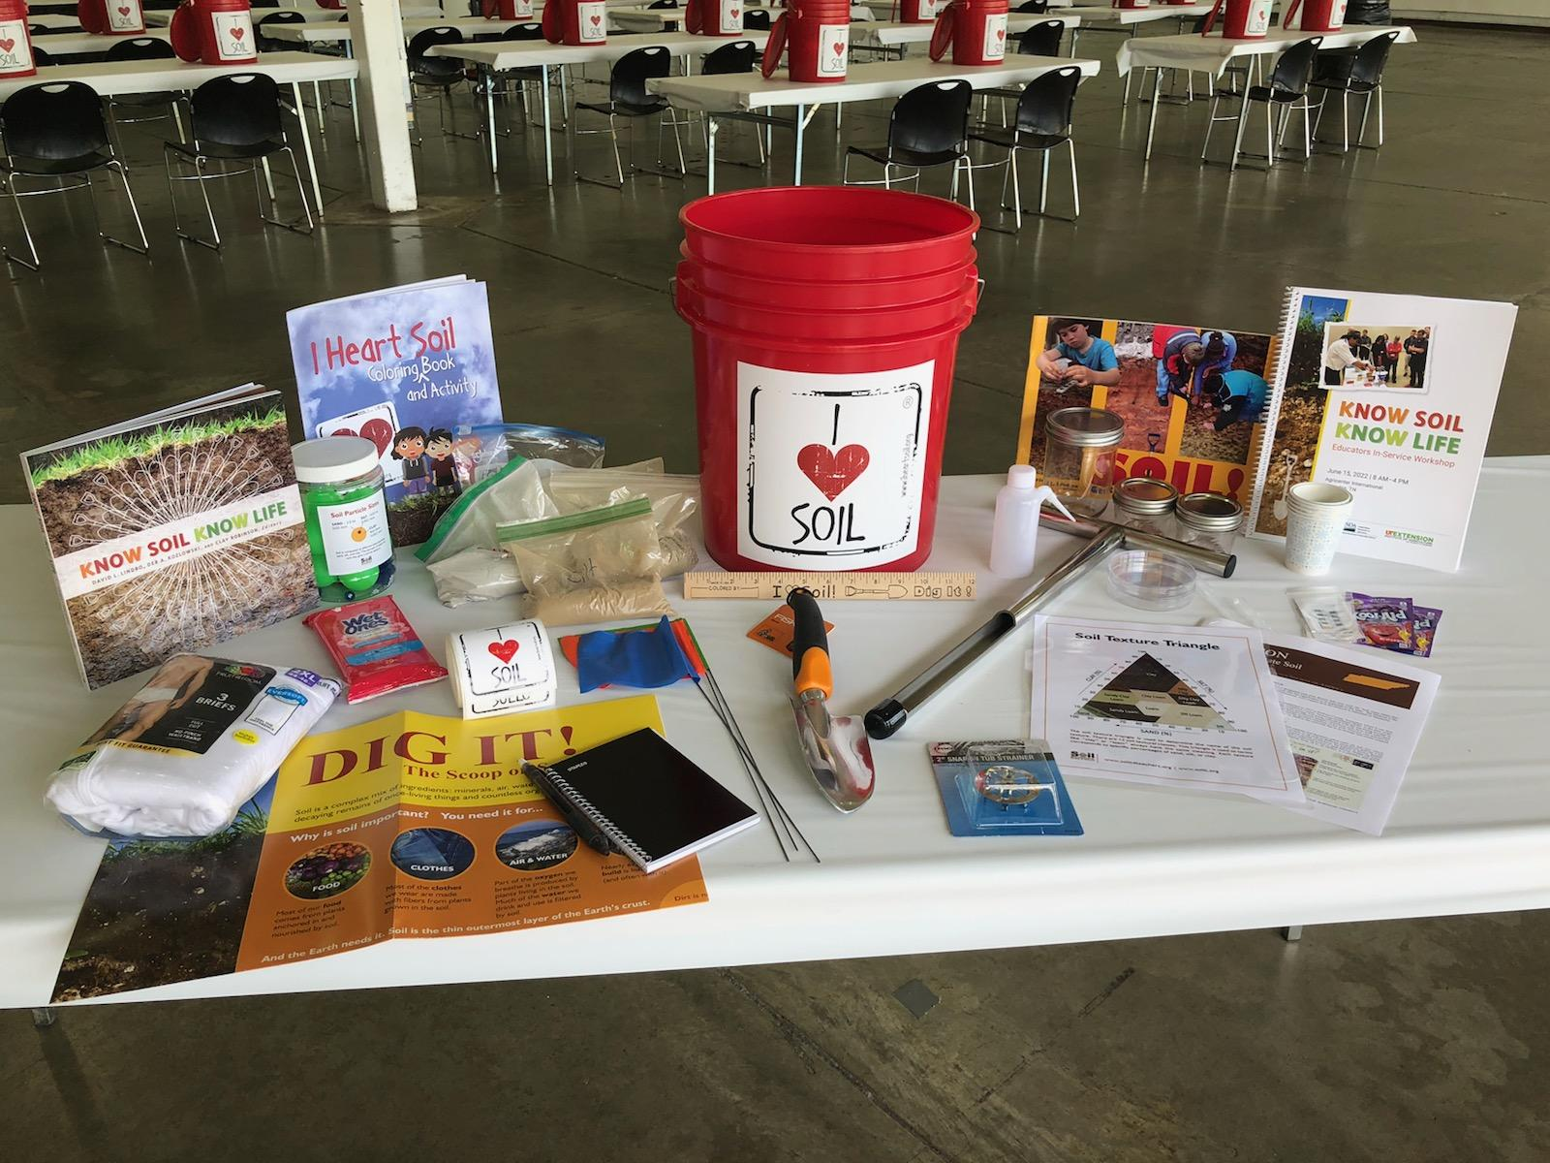
The Soil Bucket!

Slide 5
Outline
Modules
  1: Soil Sampling, Soil Basics and Physical Properties
  2: Soil Chemistry
  3: Soil Biology
  4: Soil and Climate Change
  5A: Web Tools
  5B: Resources / Classroom Connections / Wrap Up
Notes:
Mention the layout of the “workbook” and workshop website

Slide 6
Why Study Soil?
Task:
What does “no soil, no life” mean to you? Add one idea to each sticky-notes (use as many as you’d like)
What patterns do you see in the responses?

Slide 7
Today!
We’ll go from …
No Soil, No Life
to
Know Soil, Know Life

